Slide 1
Figure III-1

Slide 2
Figure III-2

Slide 3
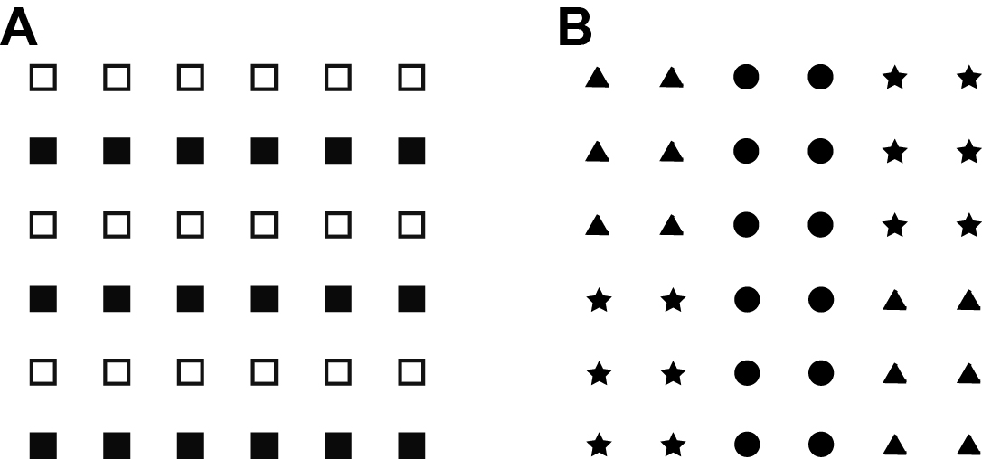
Figure III-3

Slide 4
Figure III-4

Slide 5
Figure III-5

Slide 6
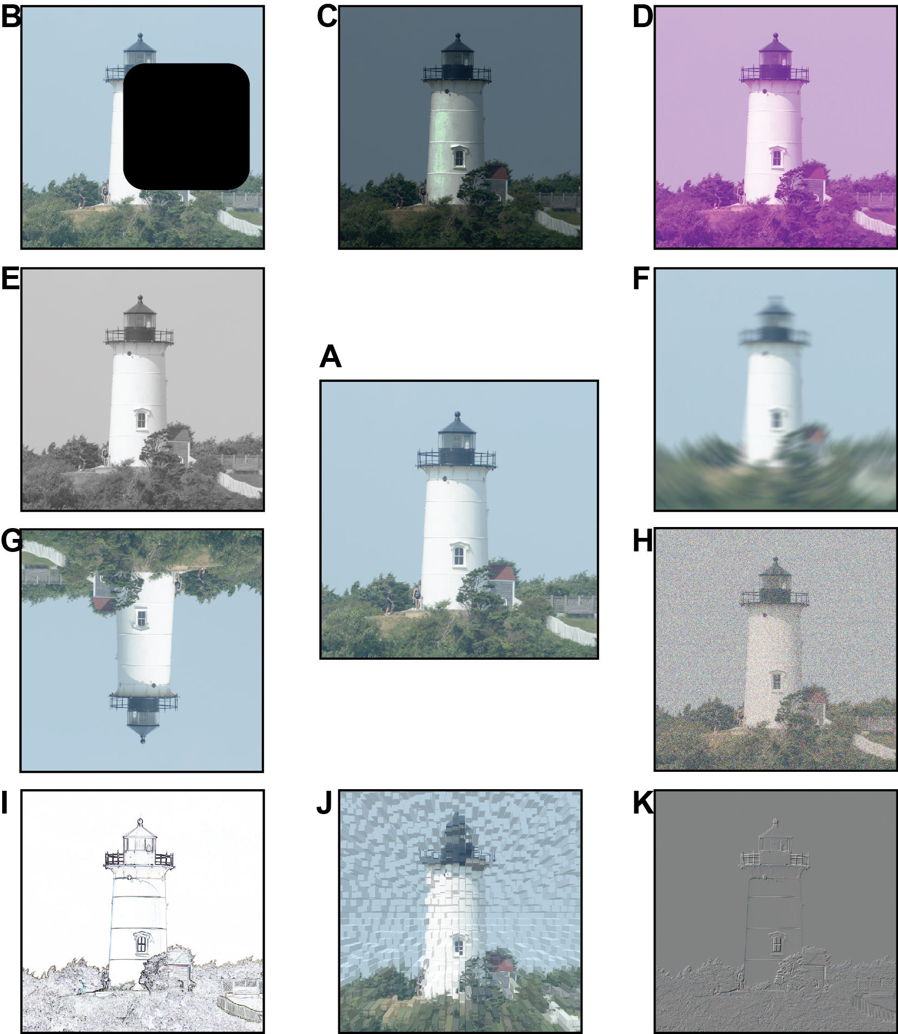
Figure III-6

Slide 7
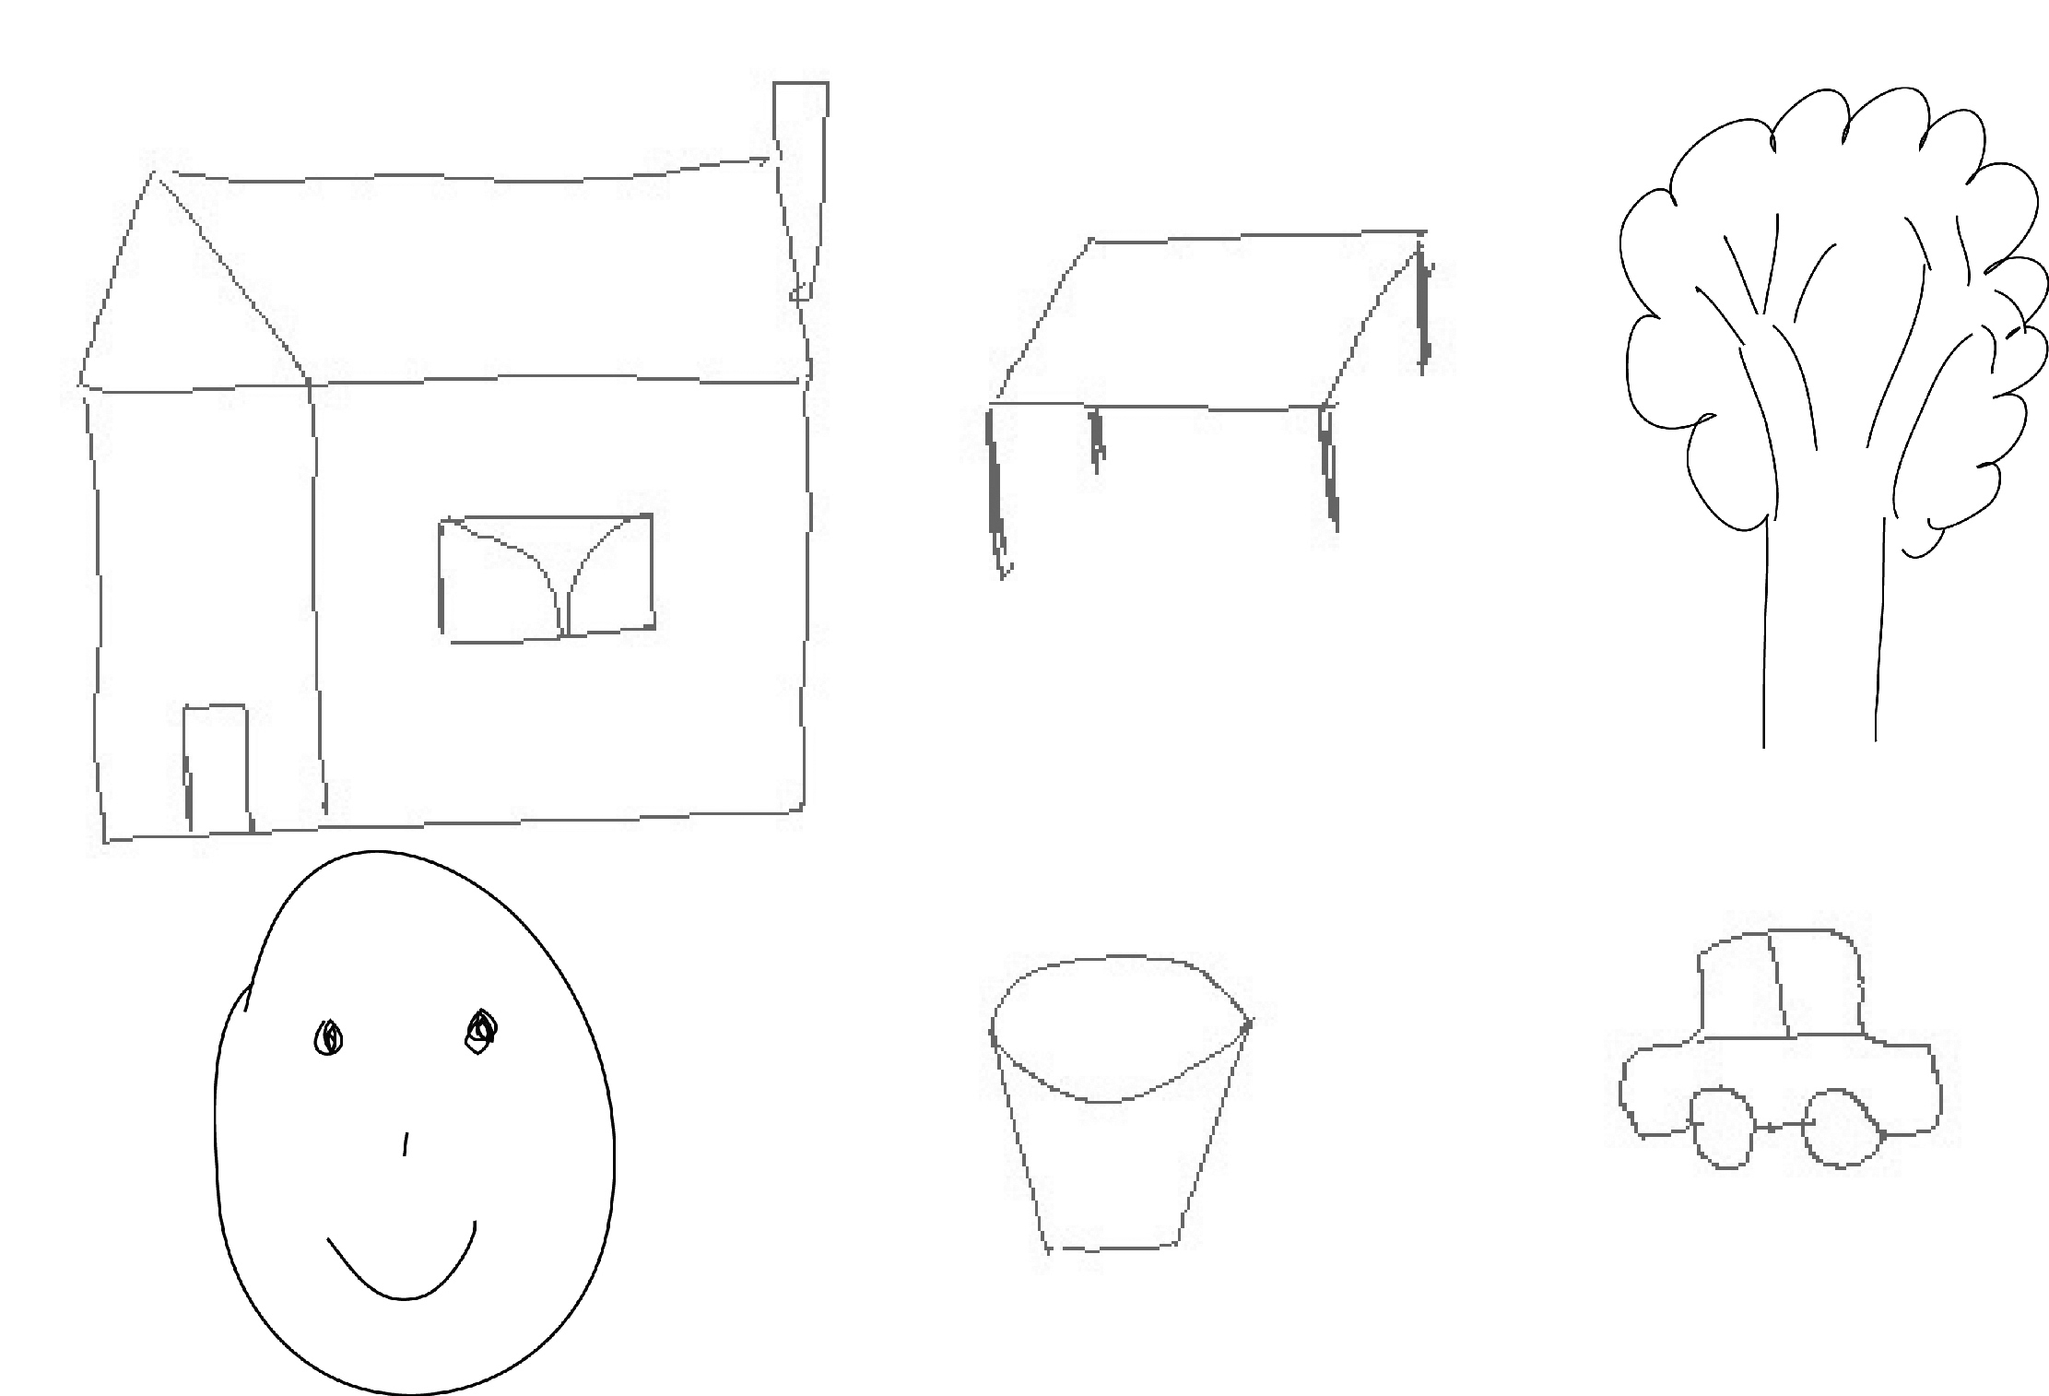
Figure III-7

Slide 8
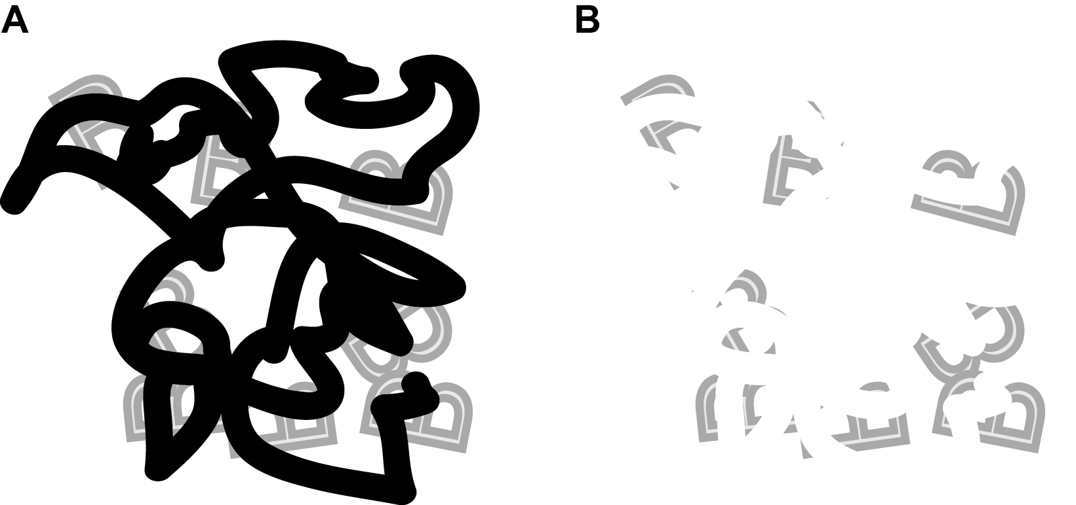
Figure III-8

Slide 9
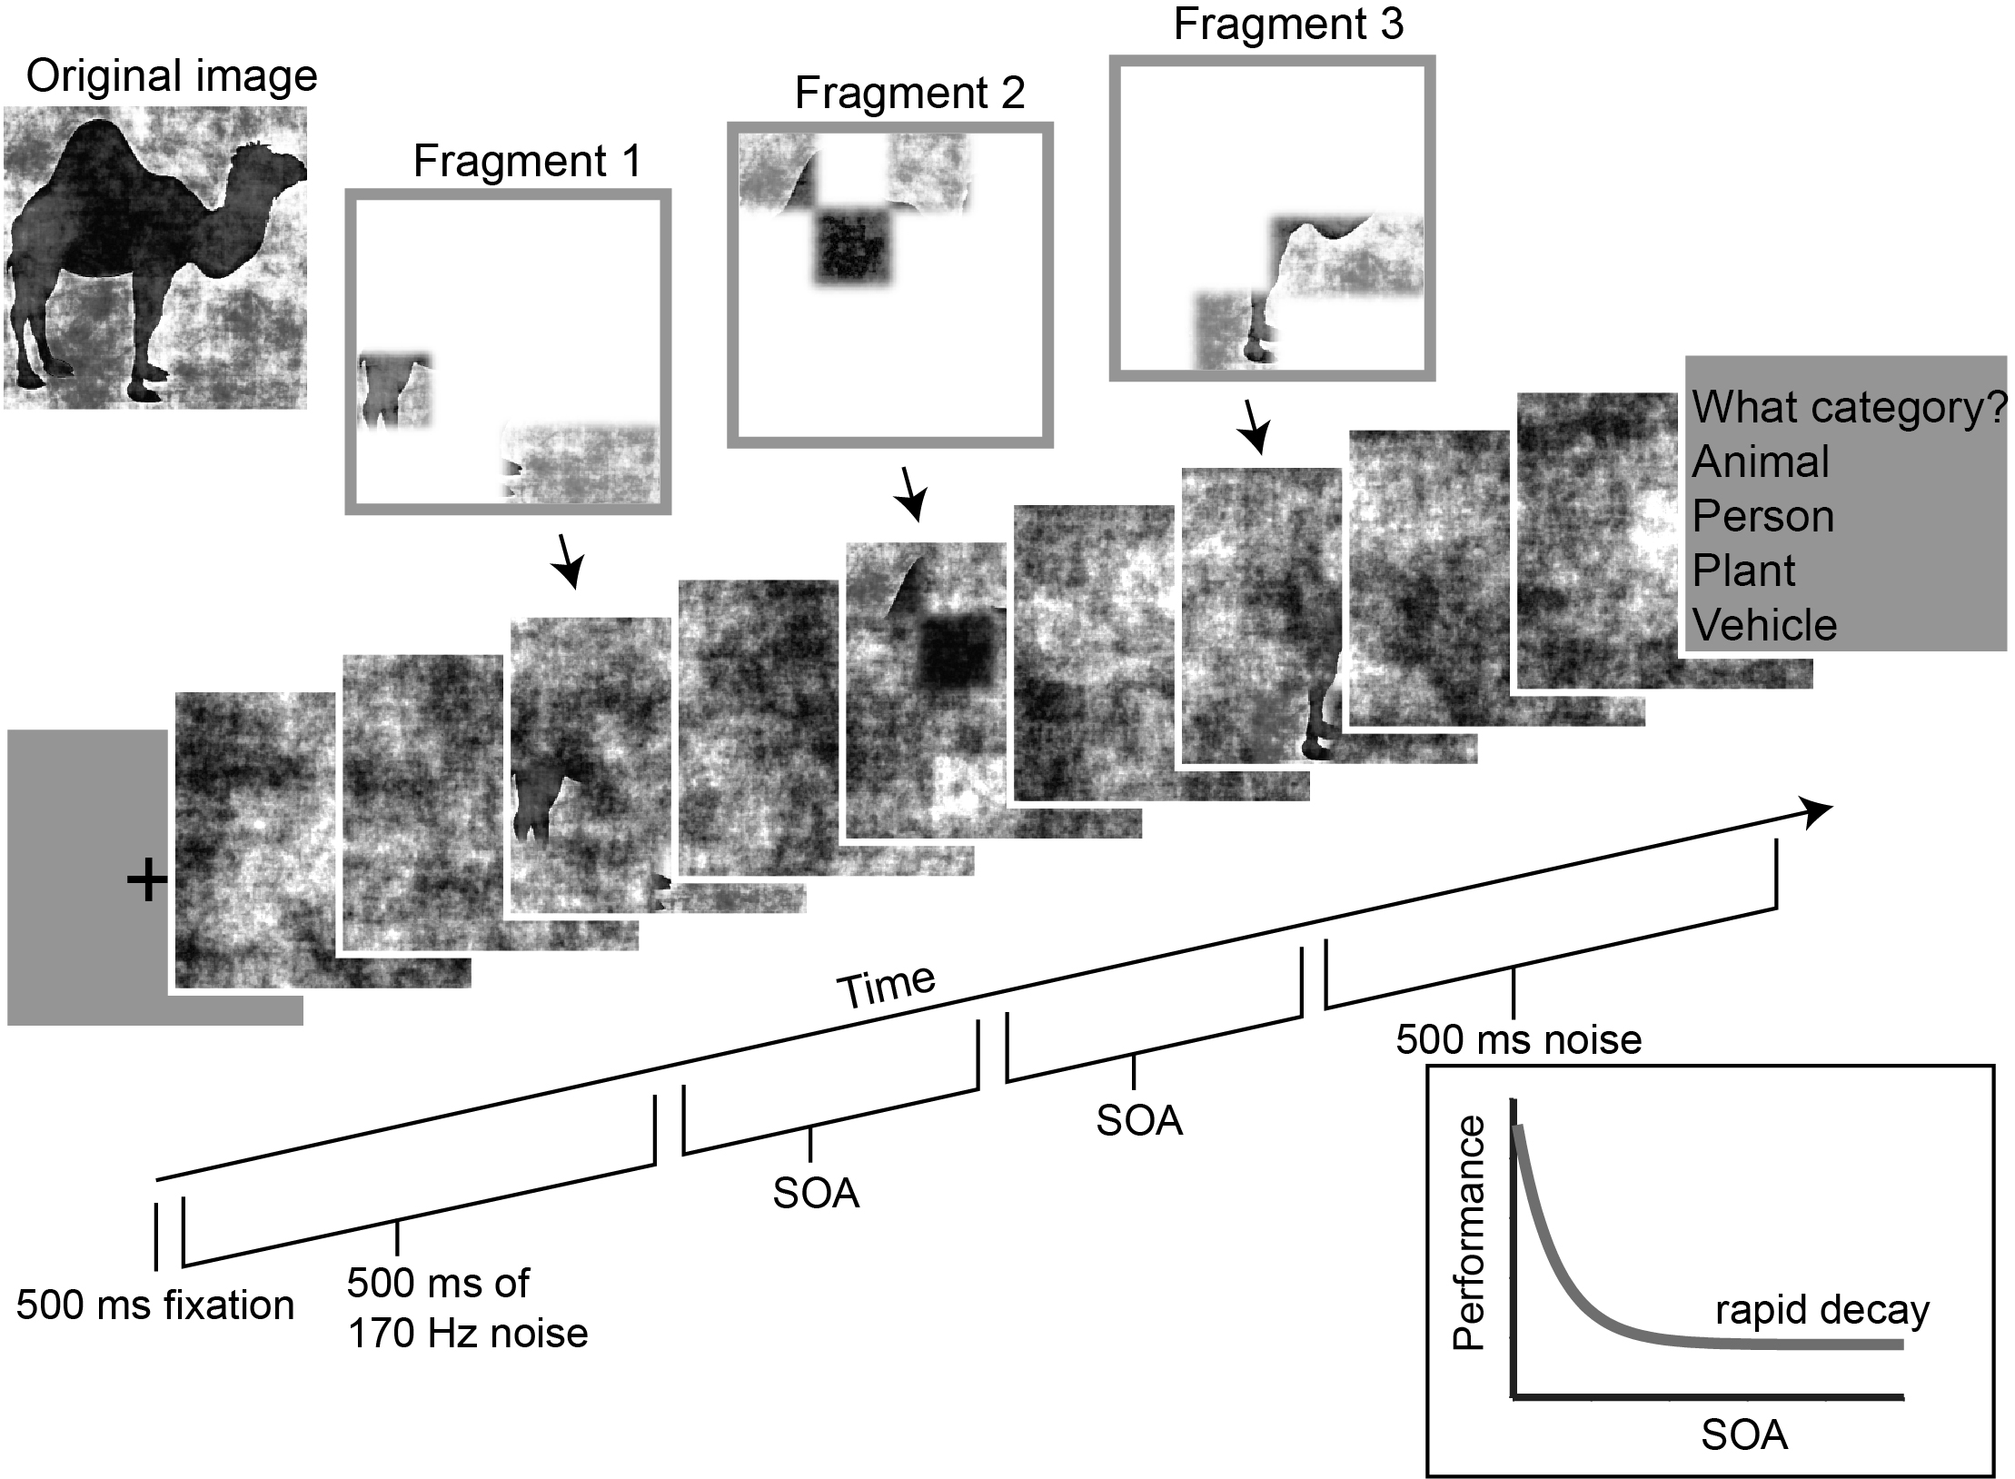
Figure III-9

Slide 10
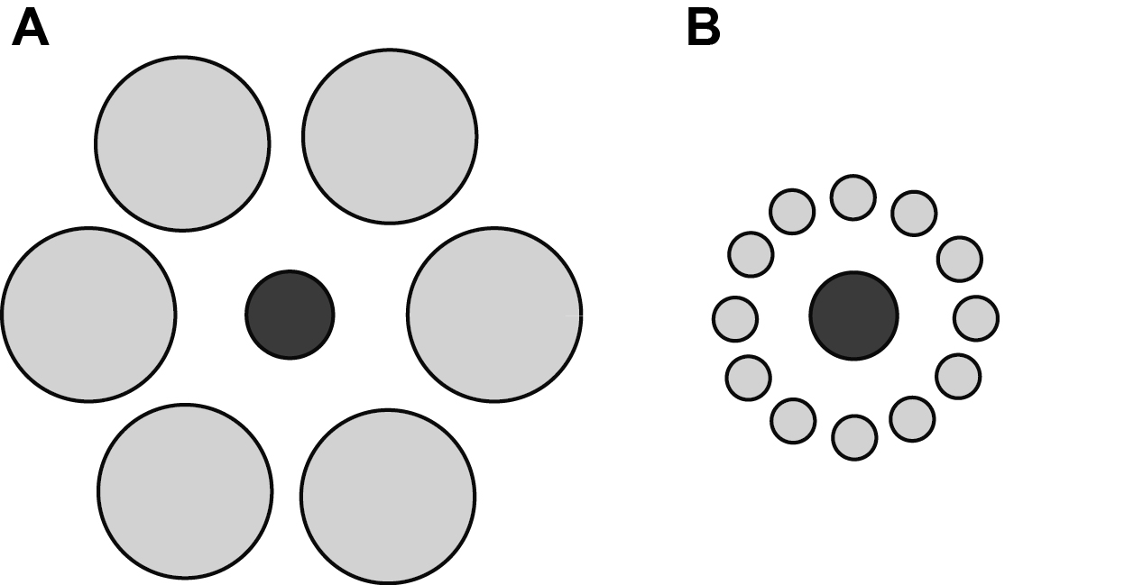
Figure III-10

Slide 11
Figure III-11

Slide 12
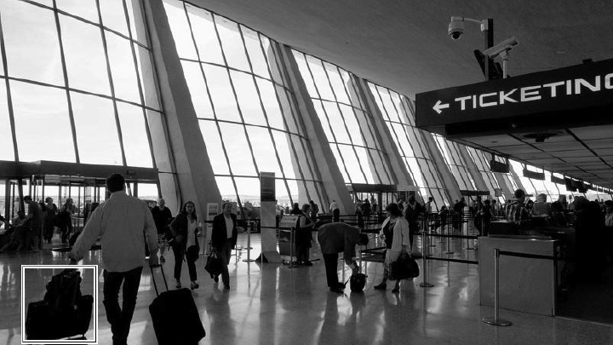
Figure III-12

Slide 13
Figure III-13

