Slide 1
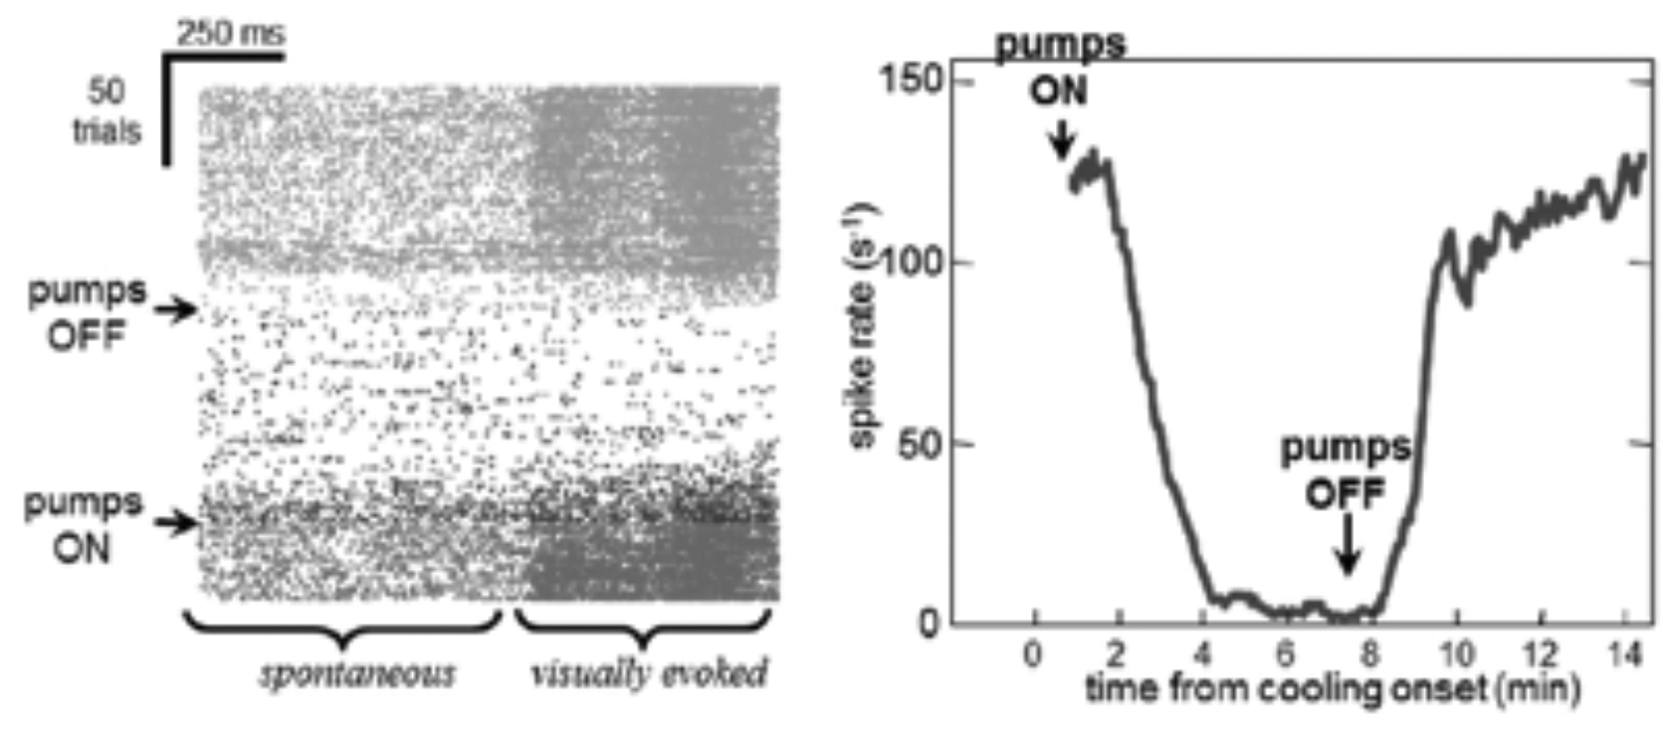
Figure IV-1

Slide 2
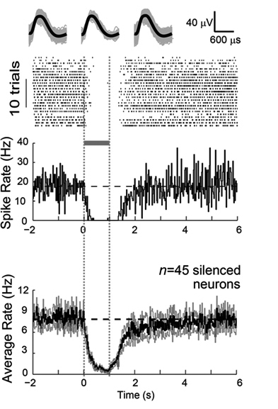
Figure IV-2

Slide 3
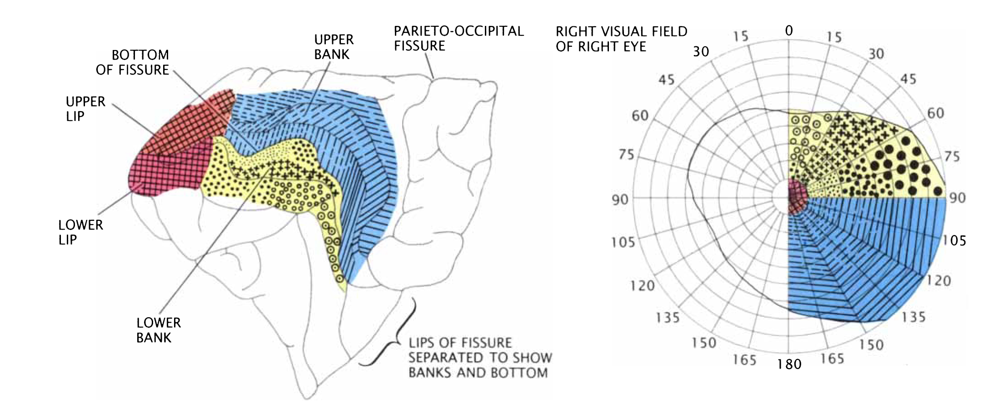
Figure IV-3

Slide 4
Figure IV-4

Slide 5
Figure IV-5

Slide 6
Figure IV-6

Slide 7
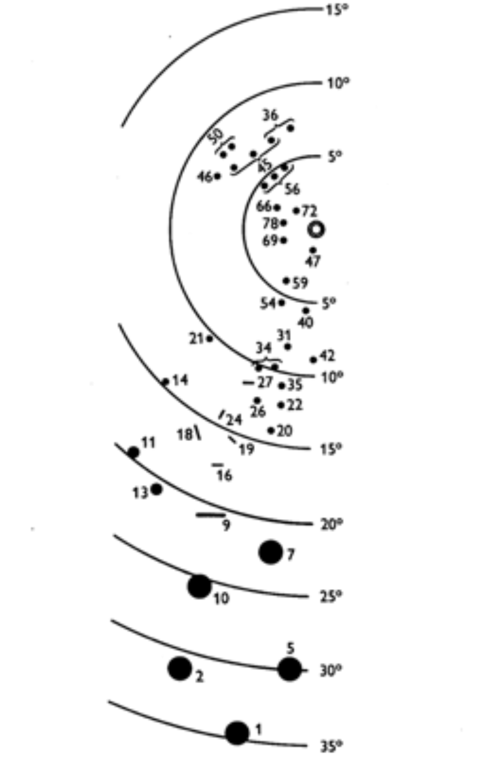
Figure IV-7

Slide 8
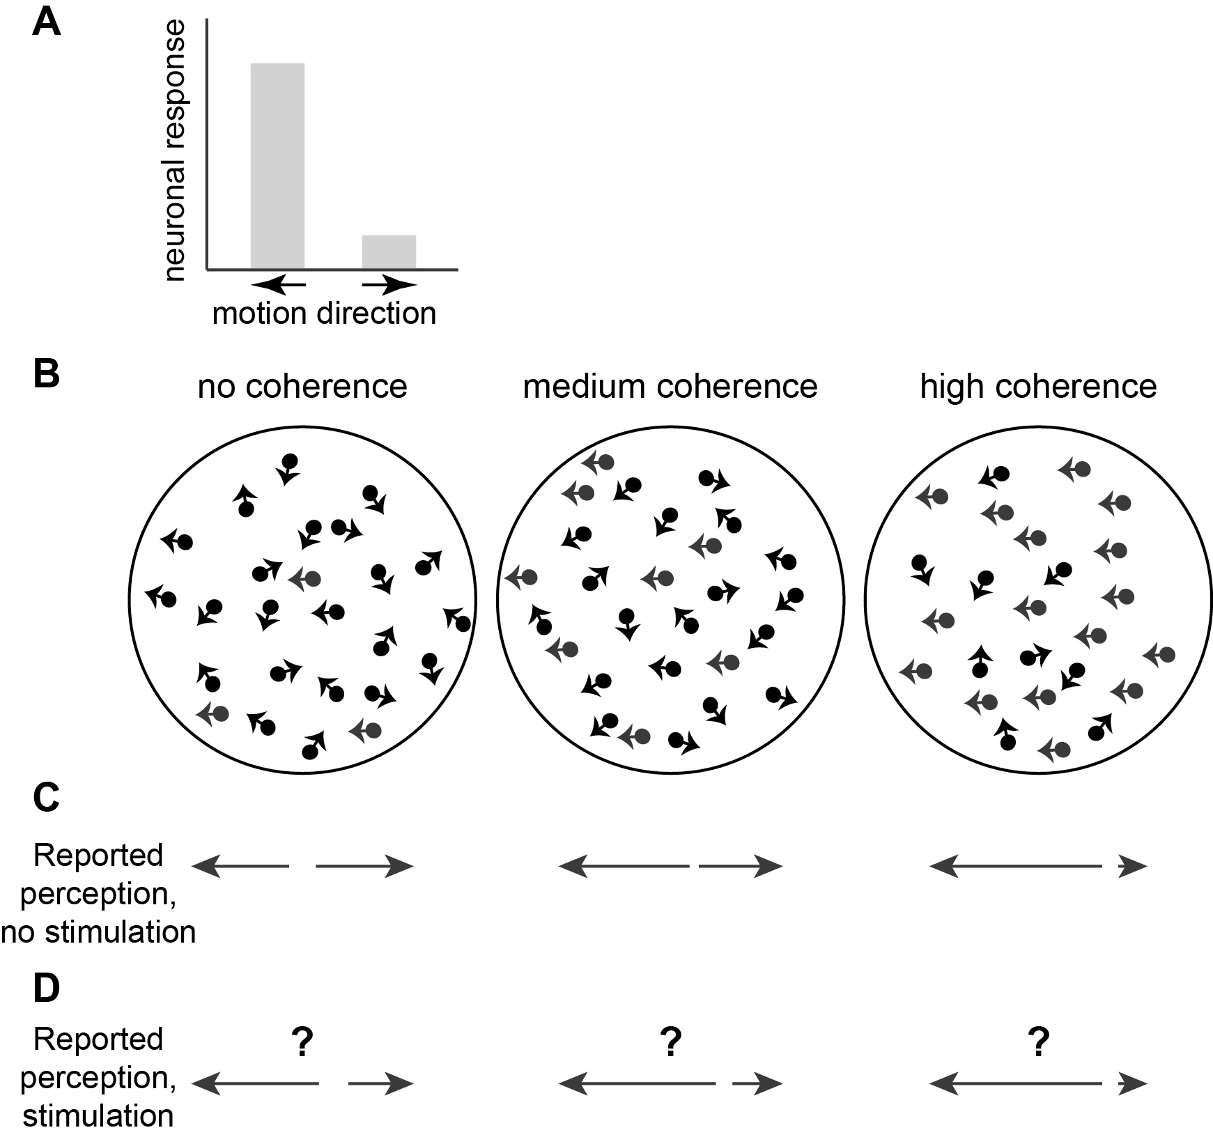
Figure IV-8

Slide 9
Figure IV-9

