Slide 1
Figure X-1

Slide 2
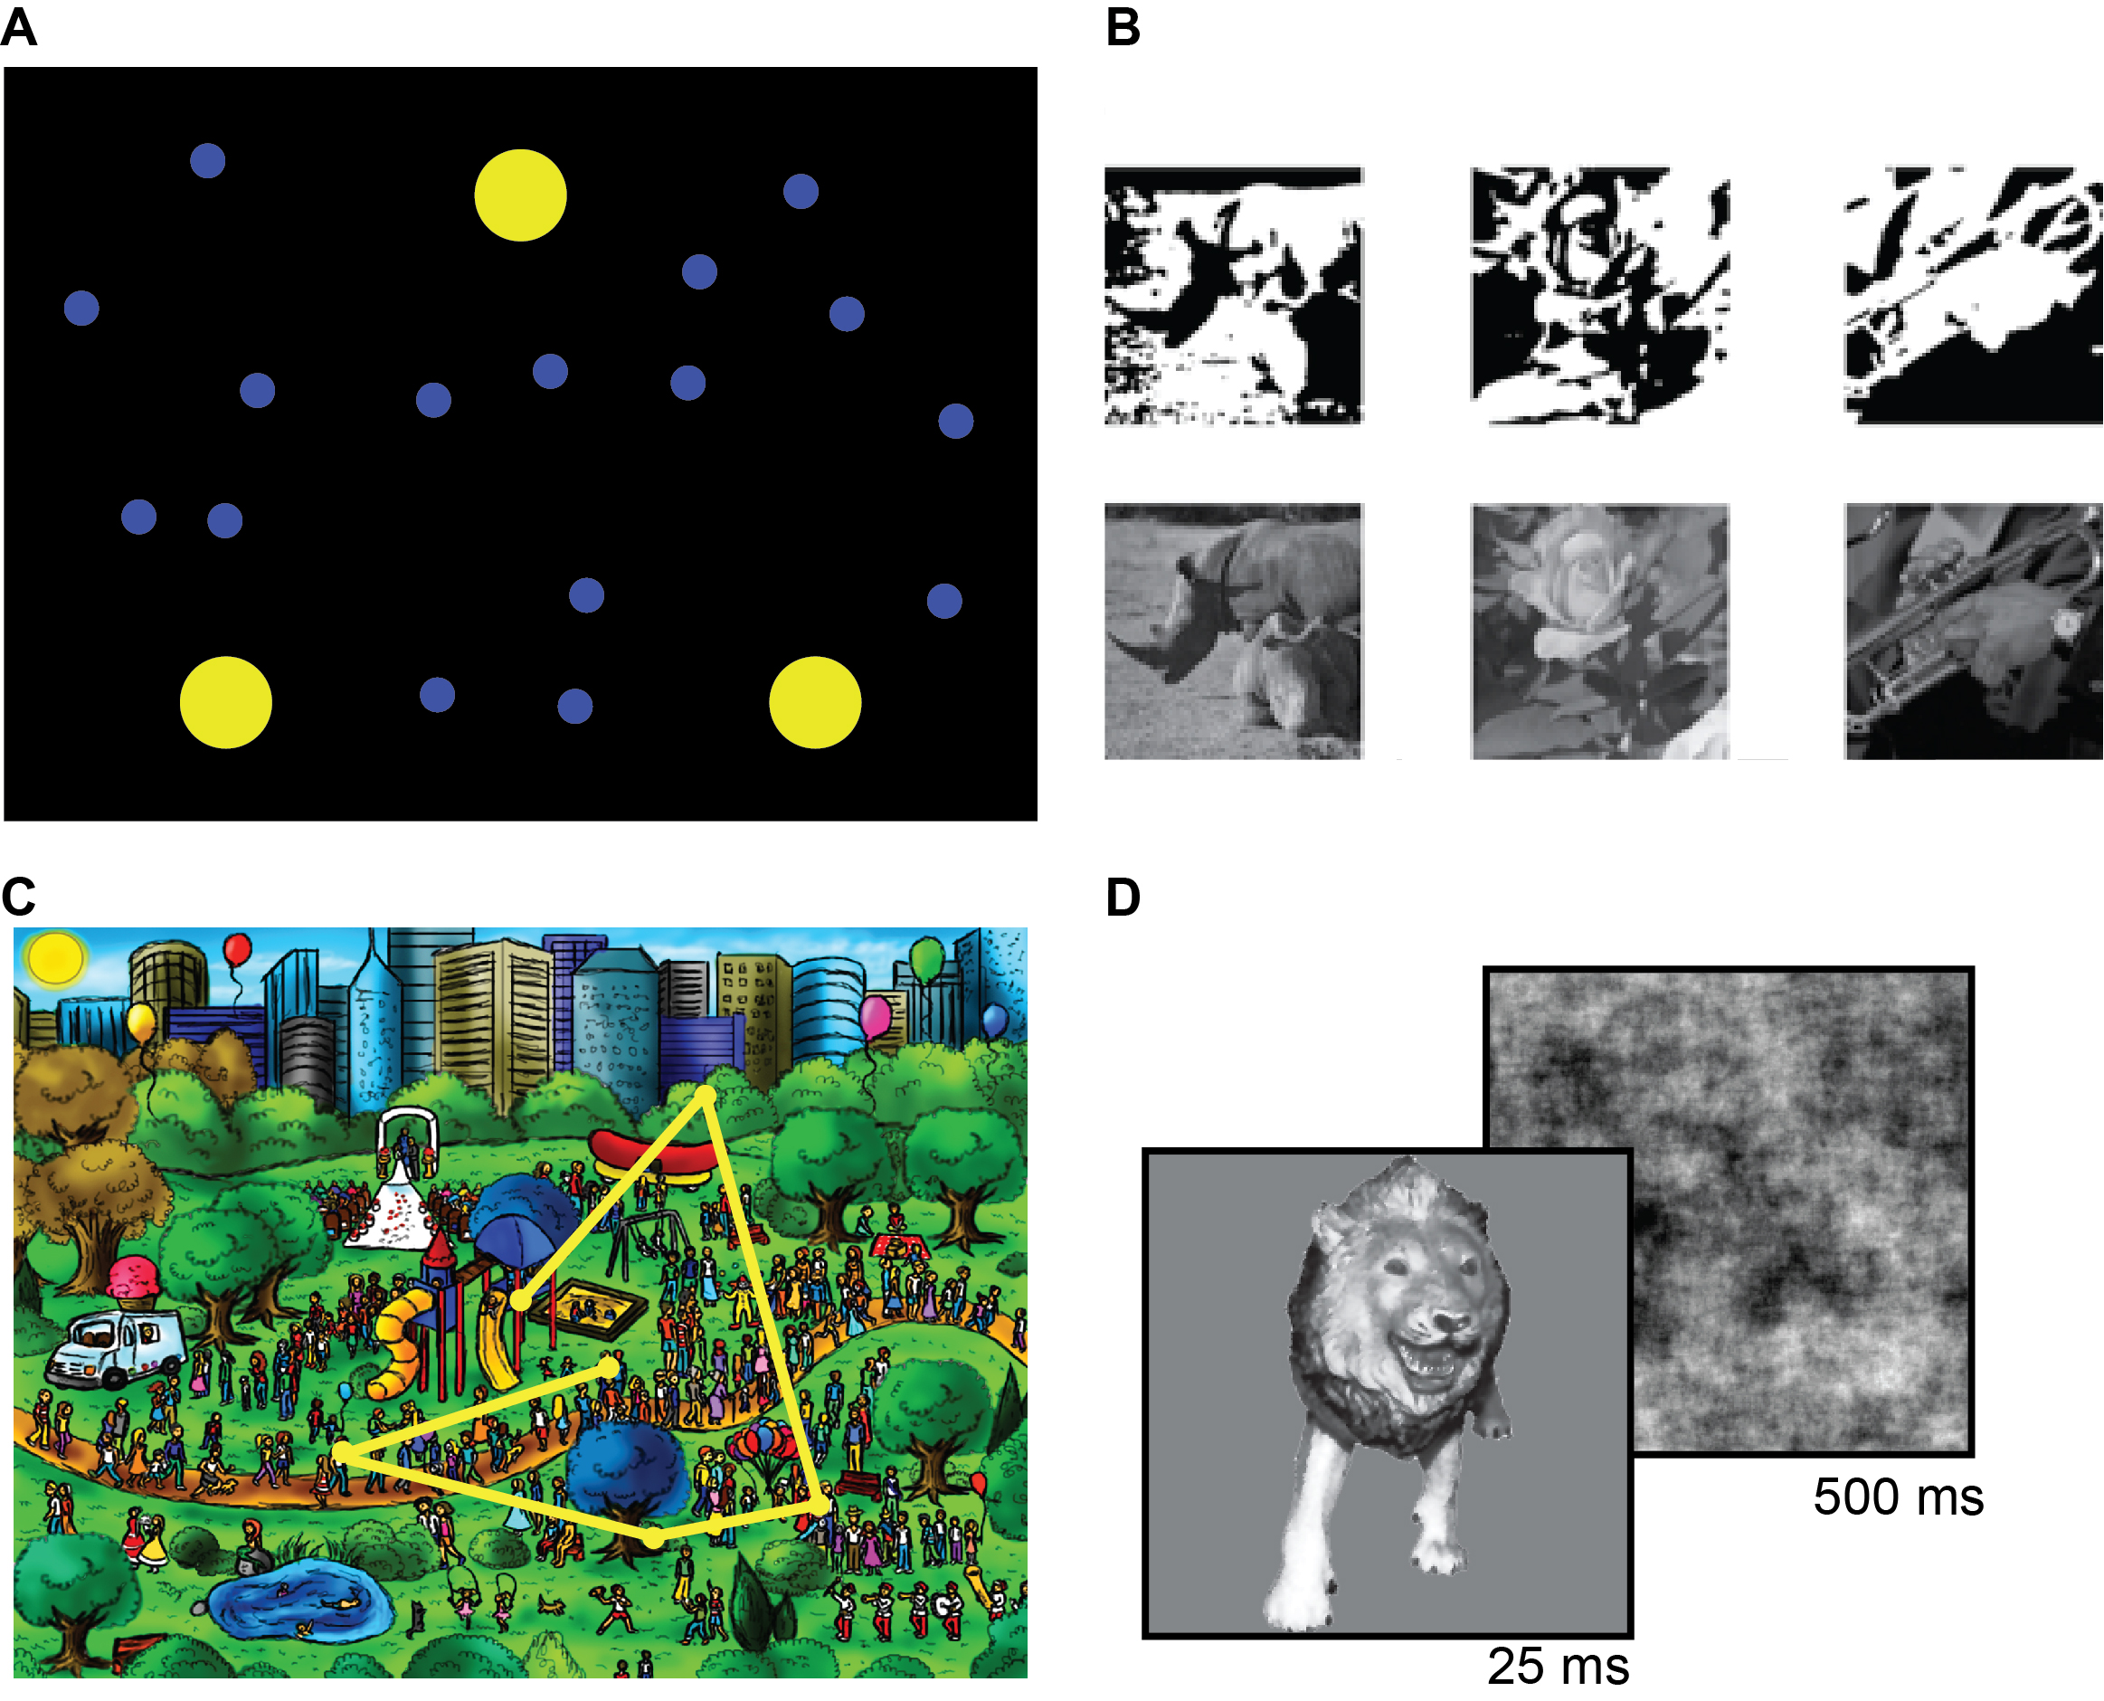
Figure X-2

Slide 3
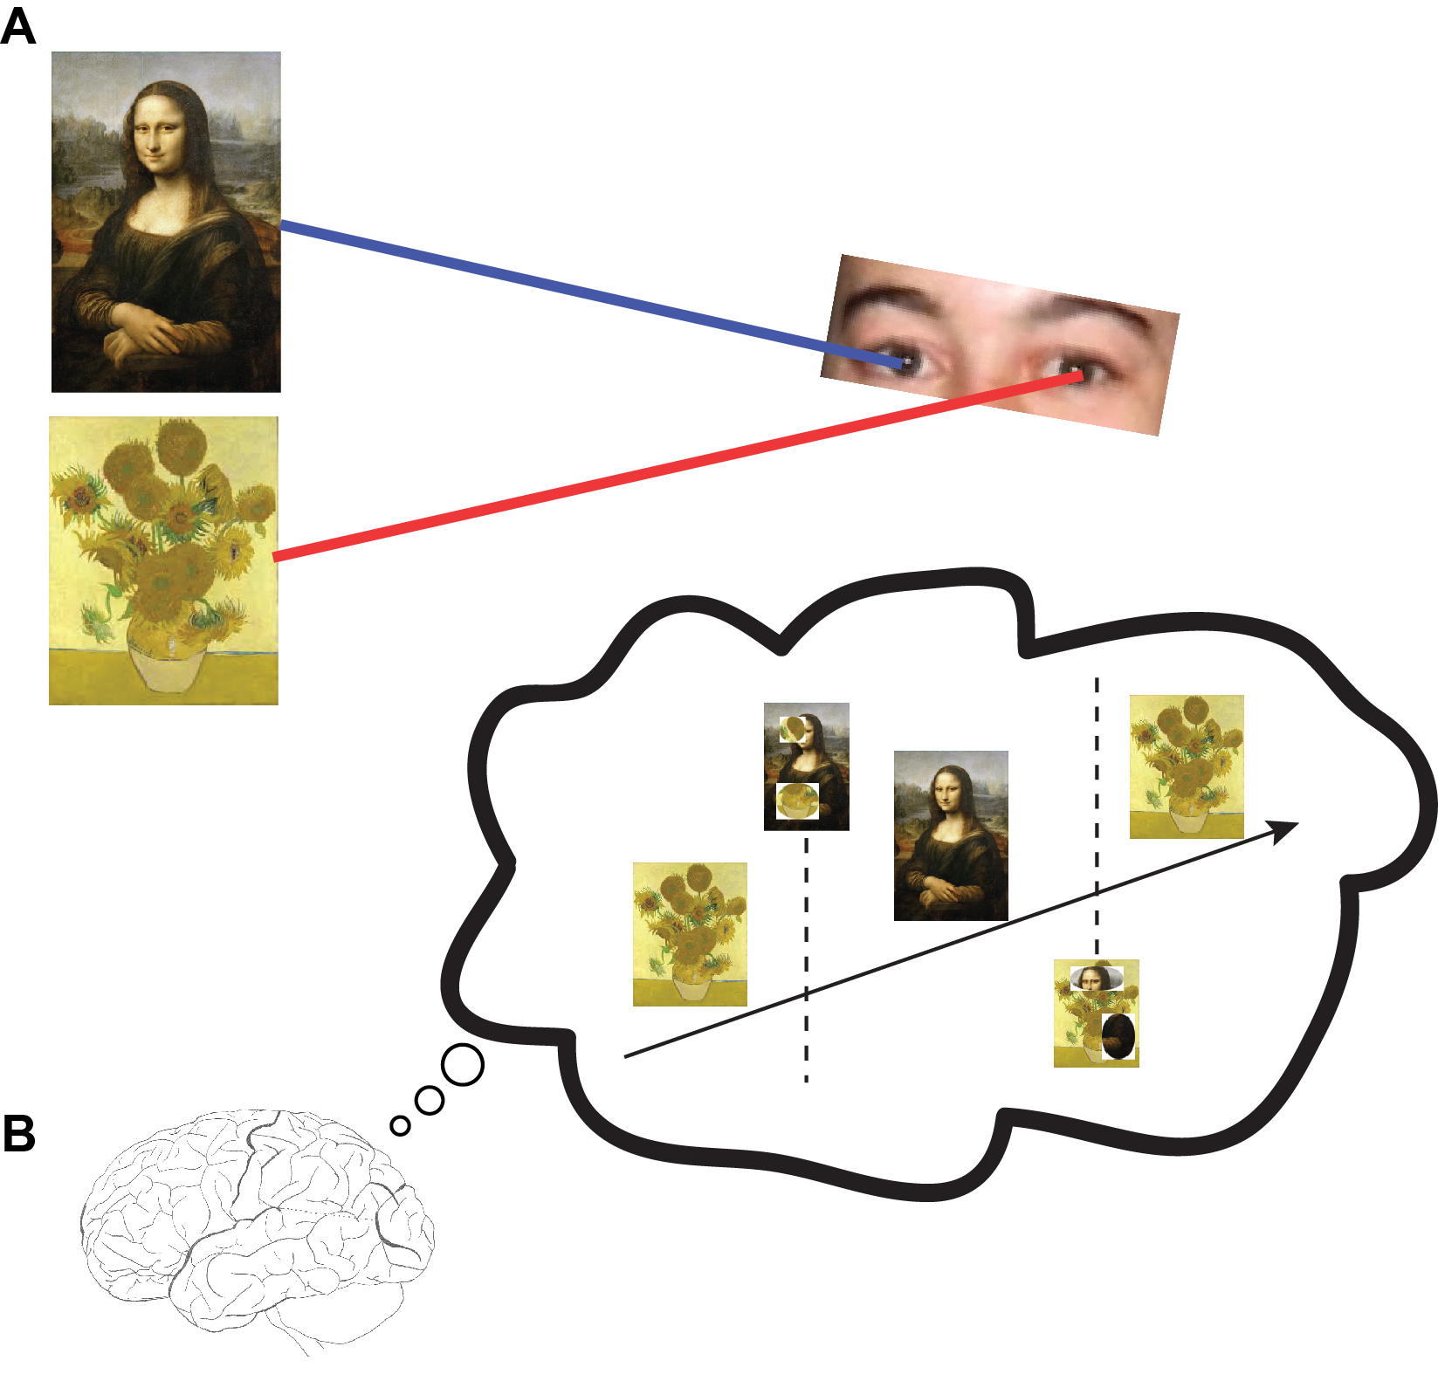
Figure X-3

Slide 4
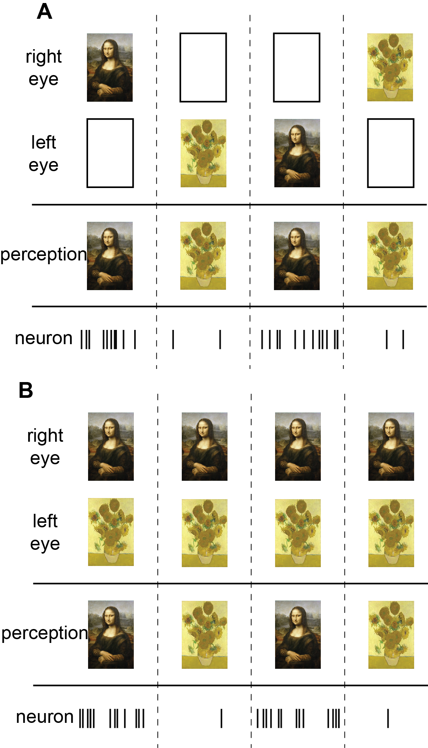
Figure X-4

Slide 5
Figure X-5

