Slide 1
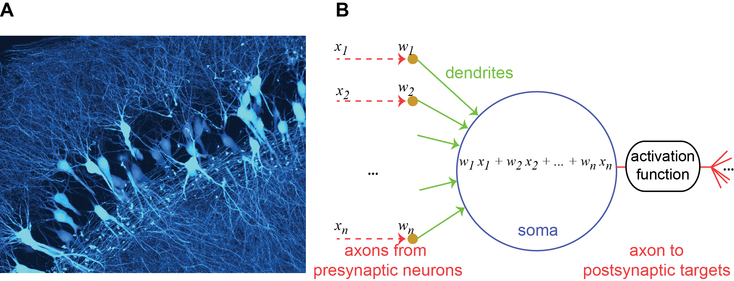
Figure VII-1

Slide 2
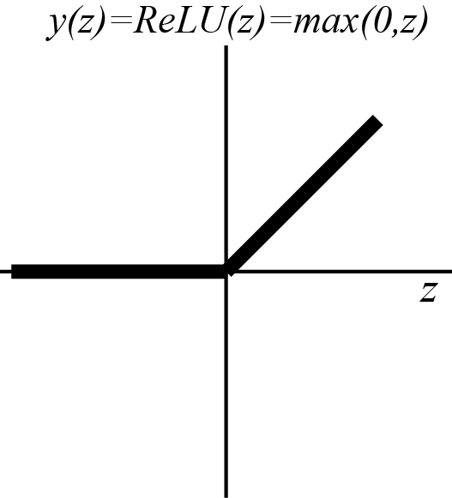
Figure VII-2

Slide 3
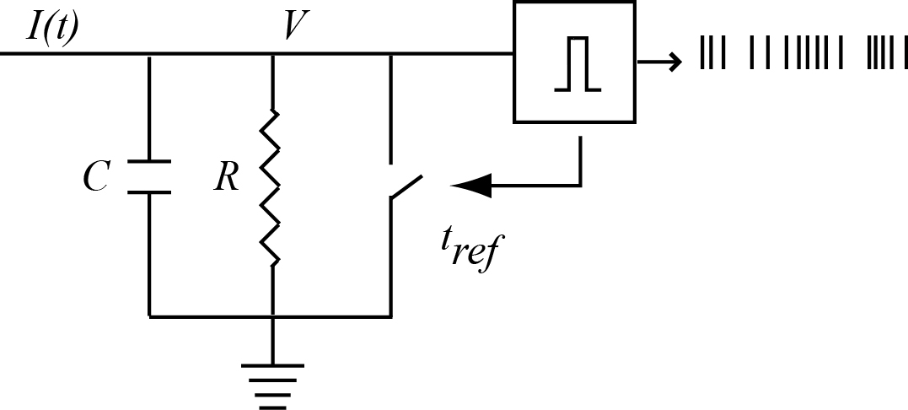
Figure VII-3

Slide 4
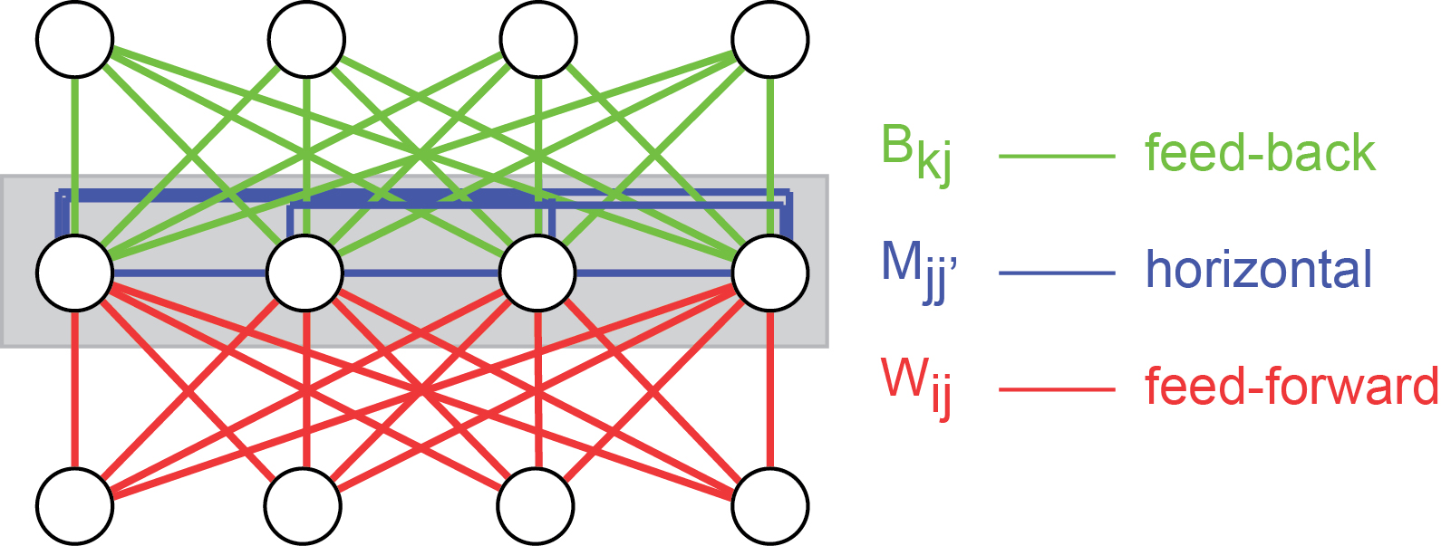
Figure VII-4

Slide 5
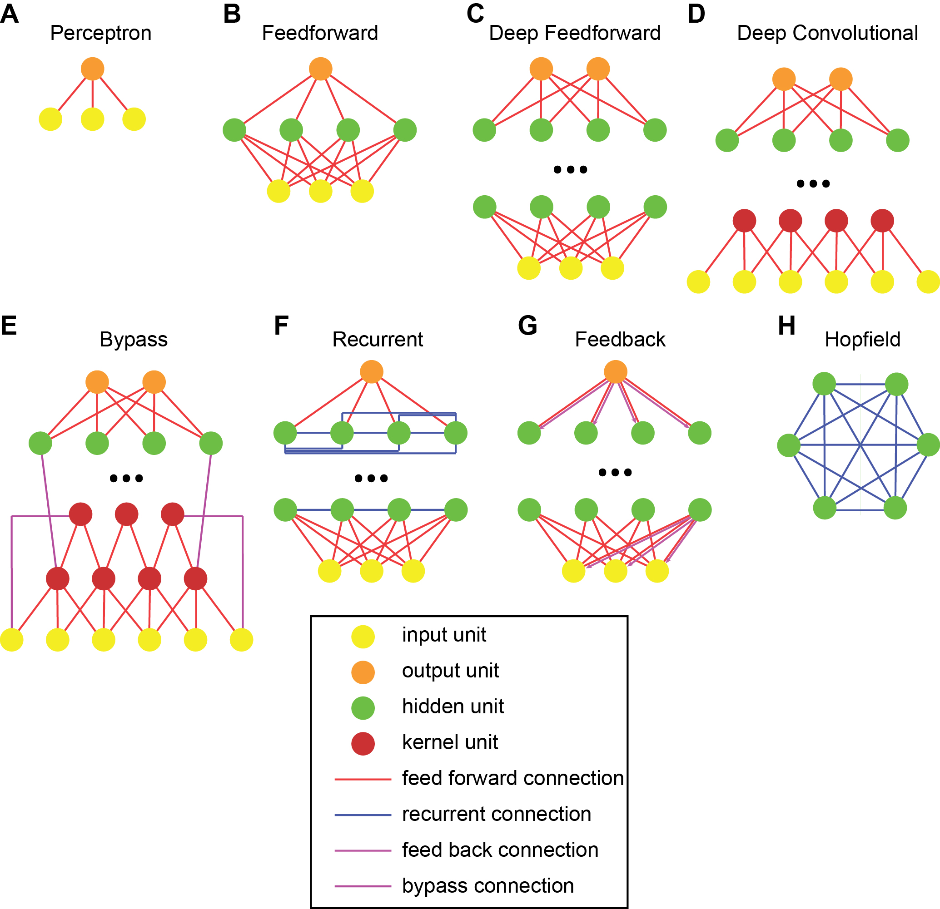
Figure VII-5

Slide 6
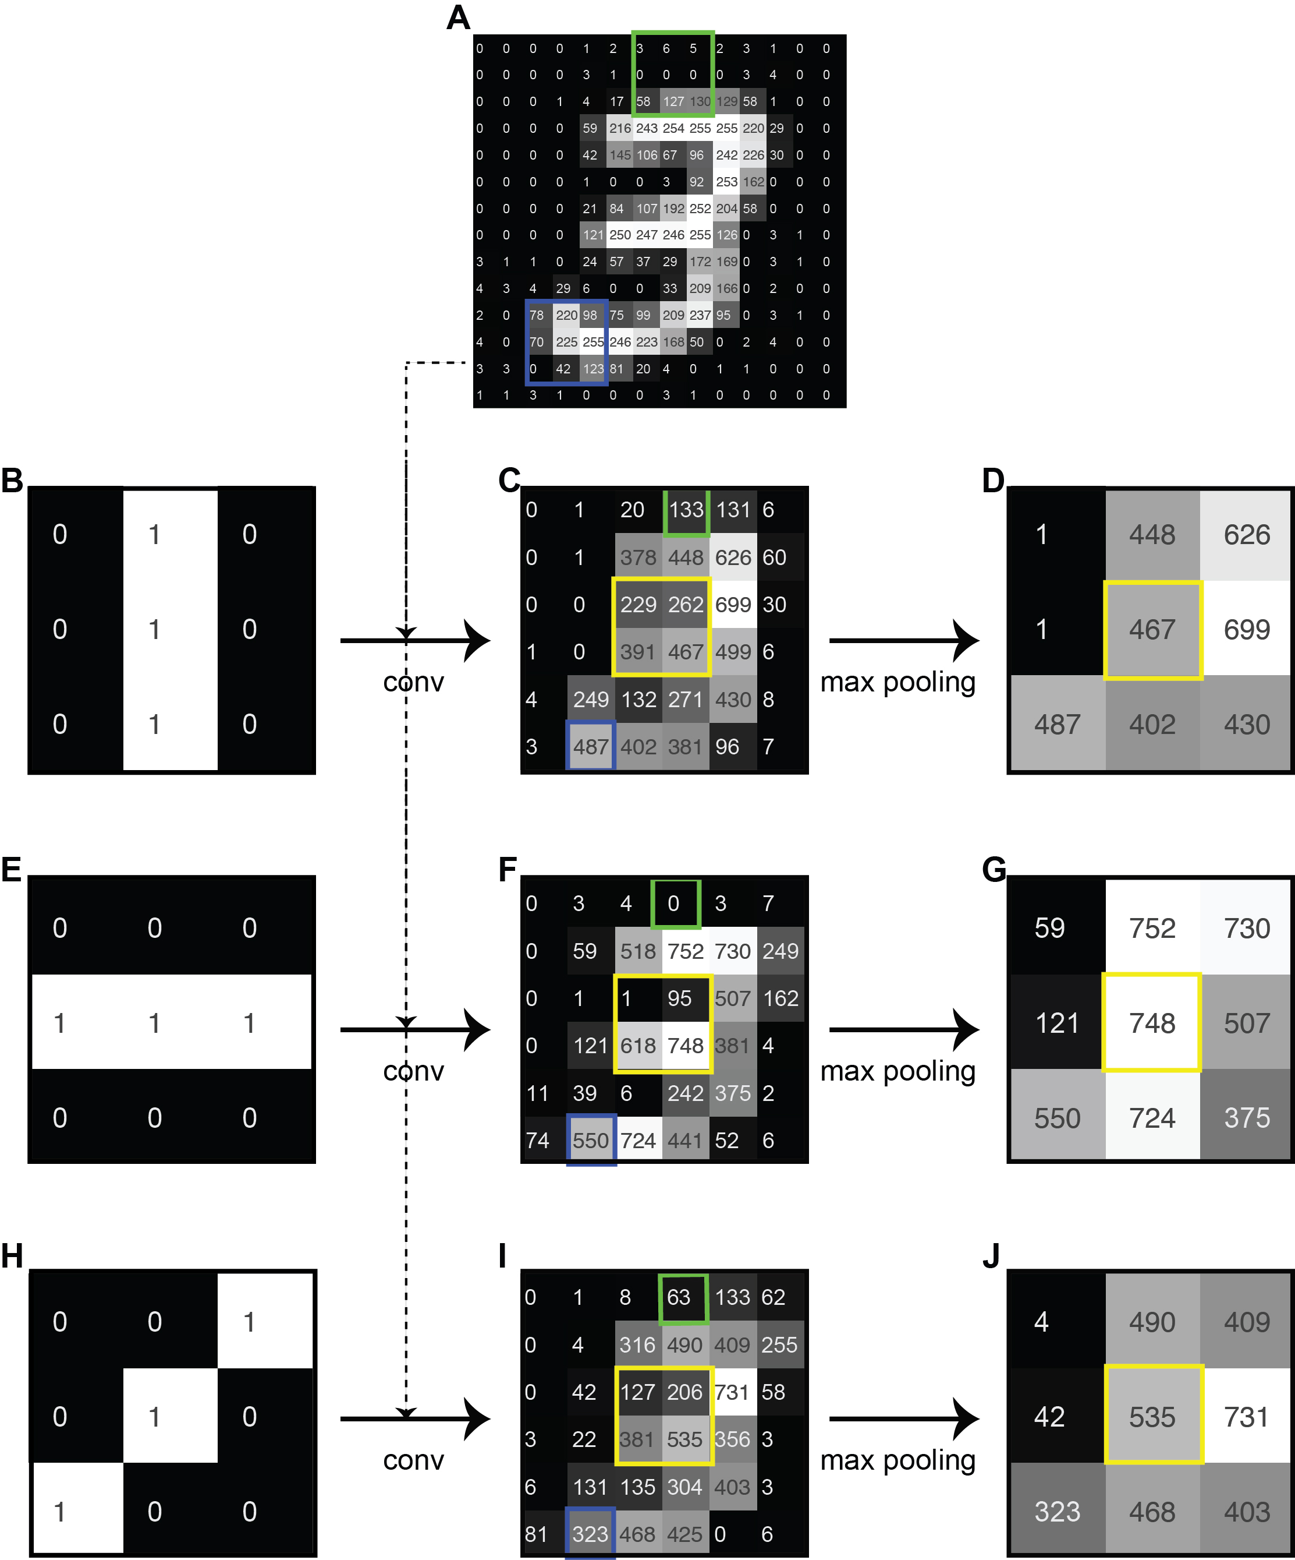
Figure VII-6

Slide 7
Figure VII-7

Slide 8
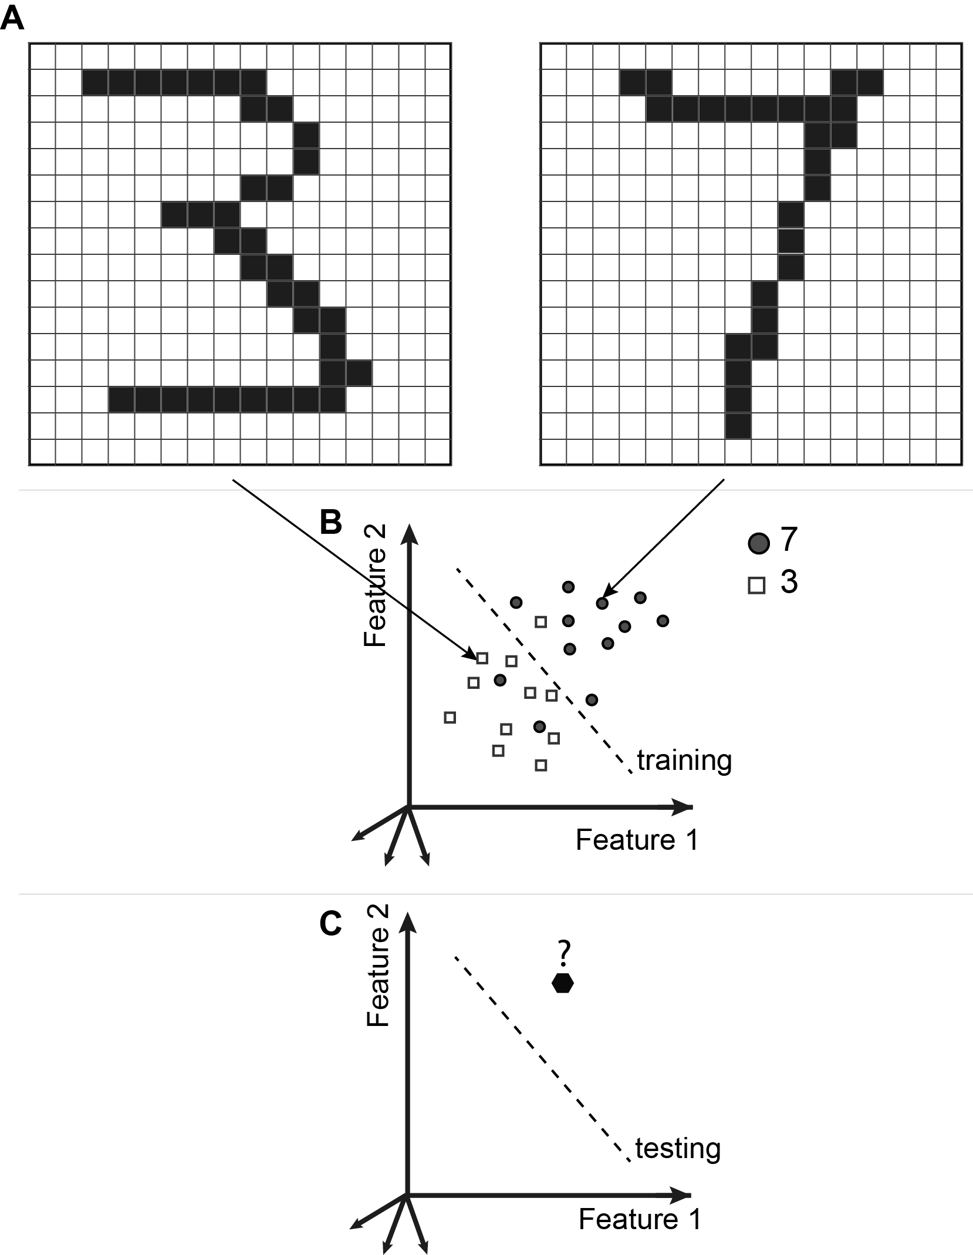
Figure VII-8

