Slide 1
Figure VIII-1

Slide 2
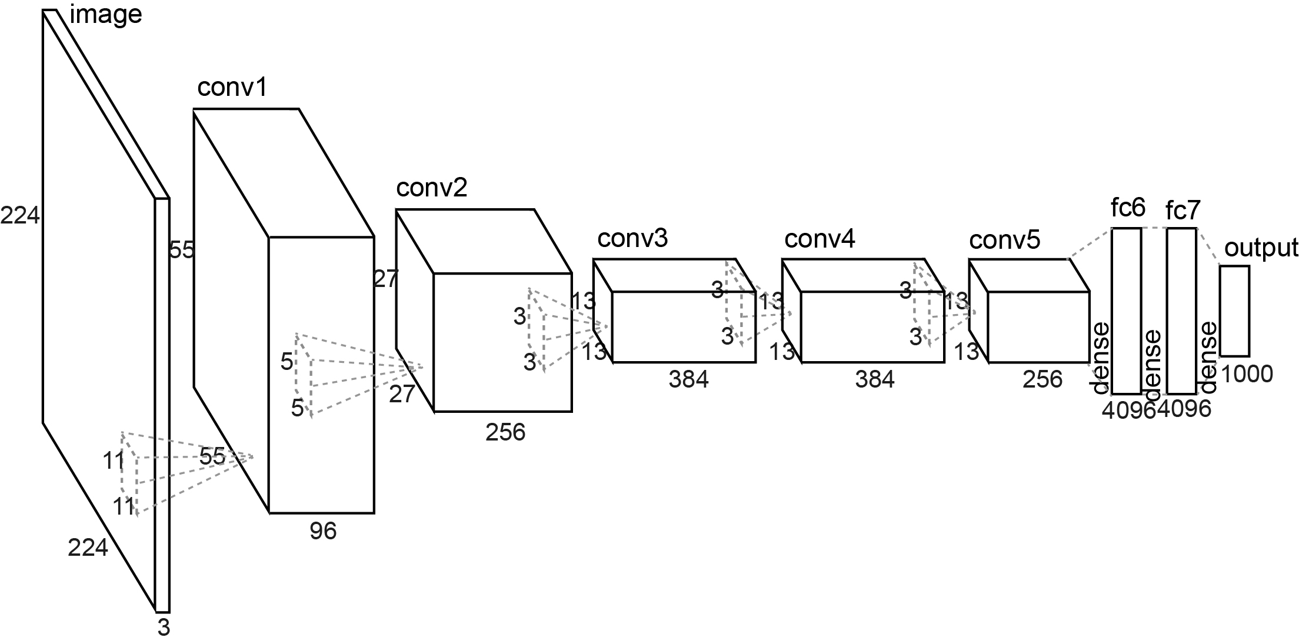
Figure VIII-2

Slide 3
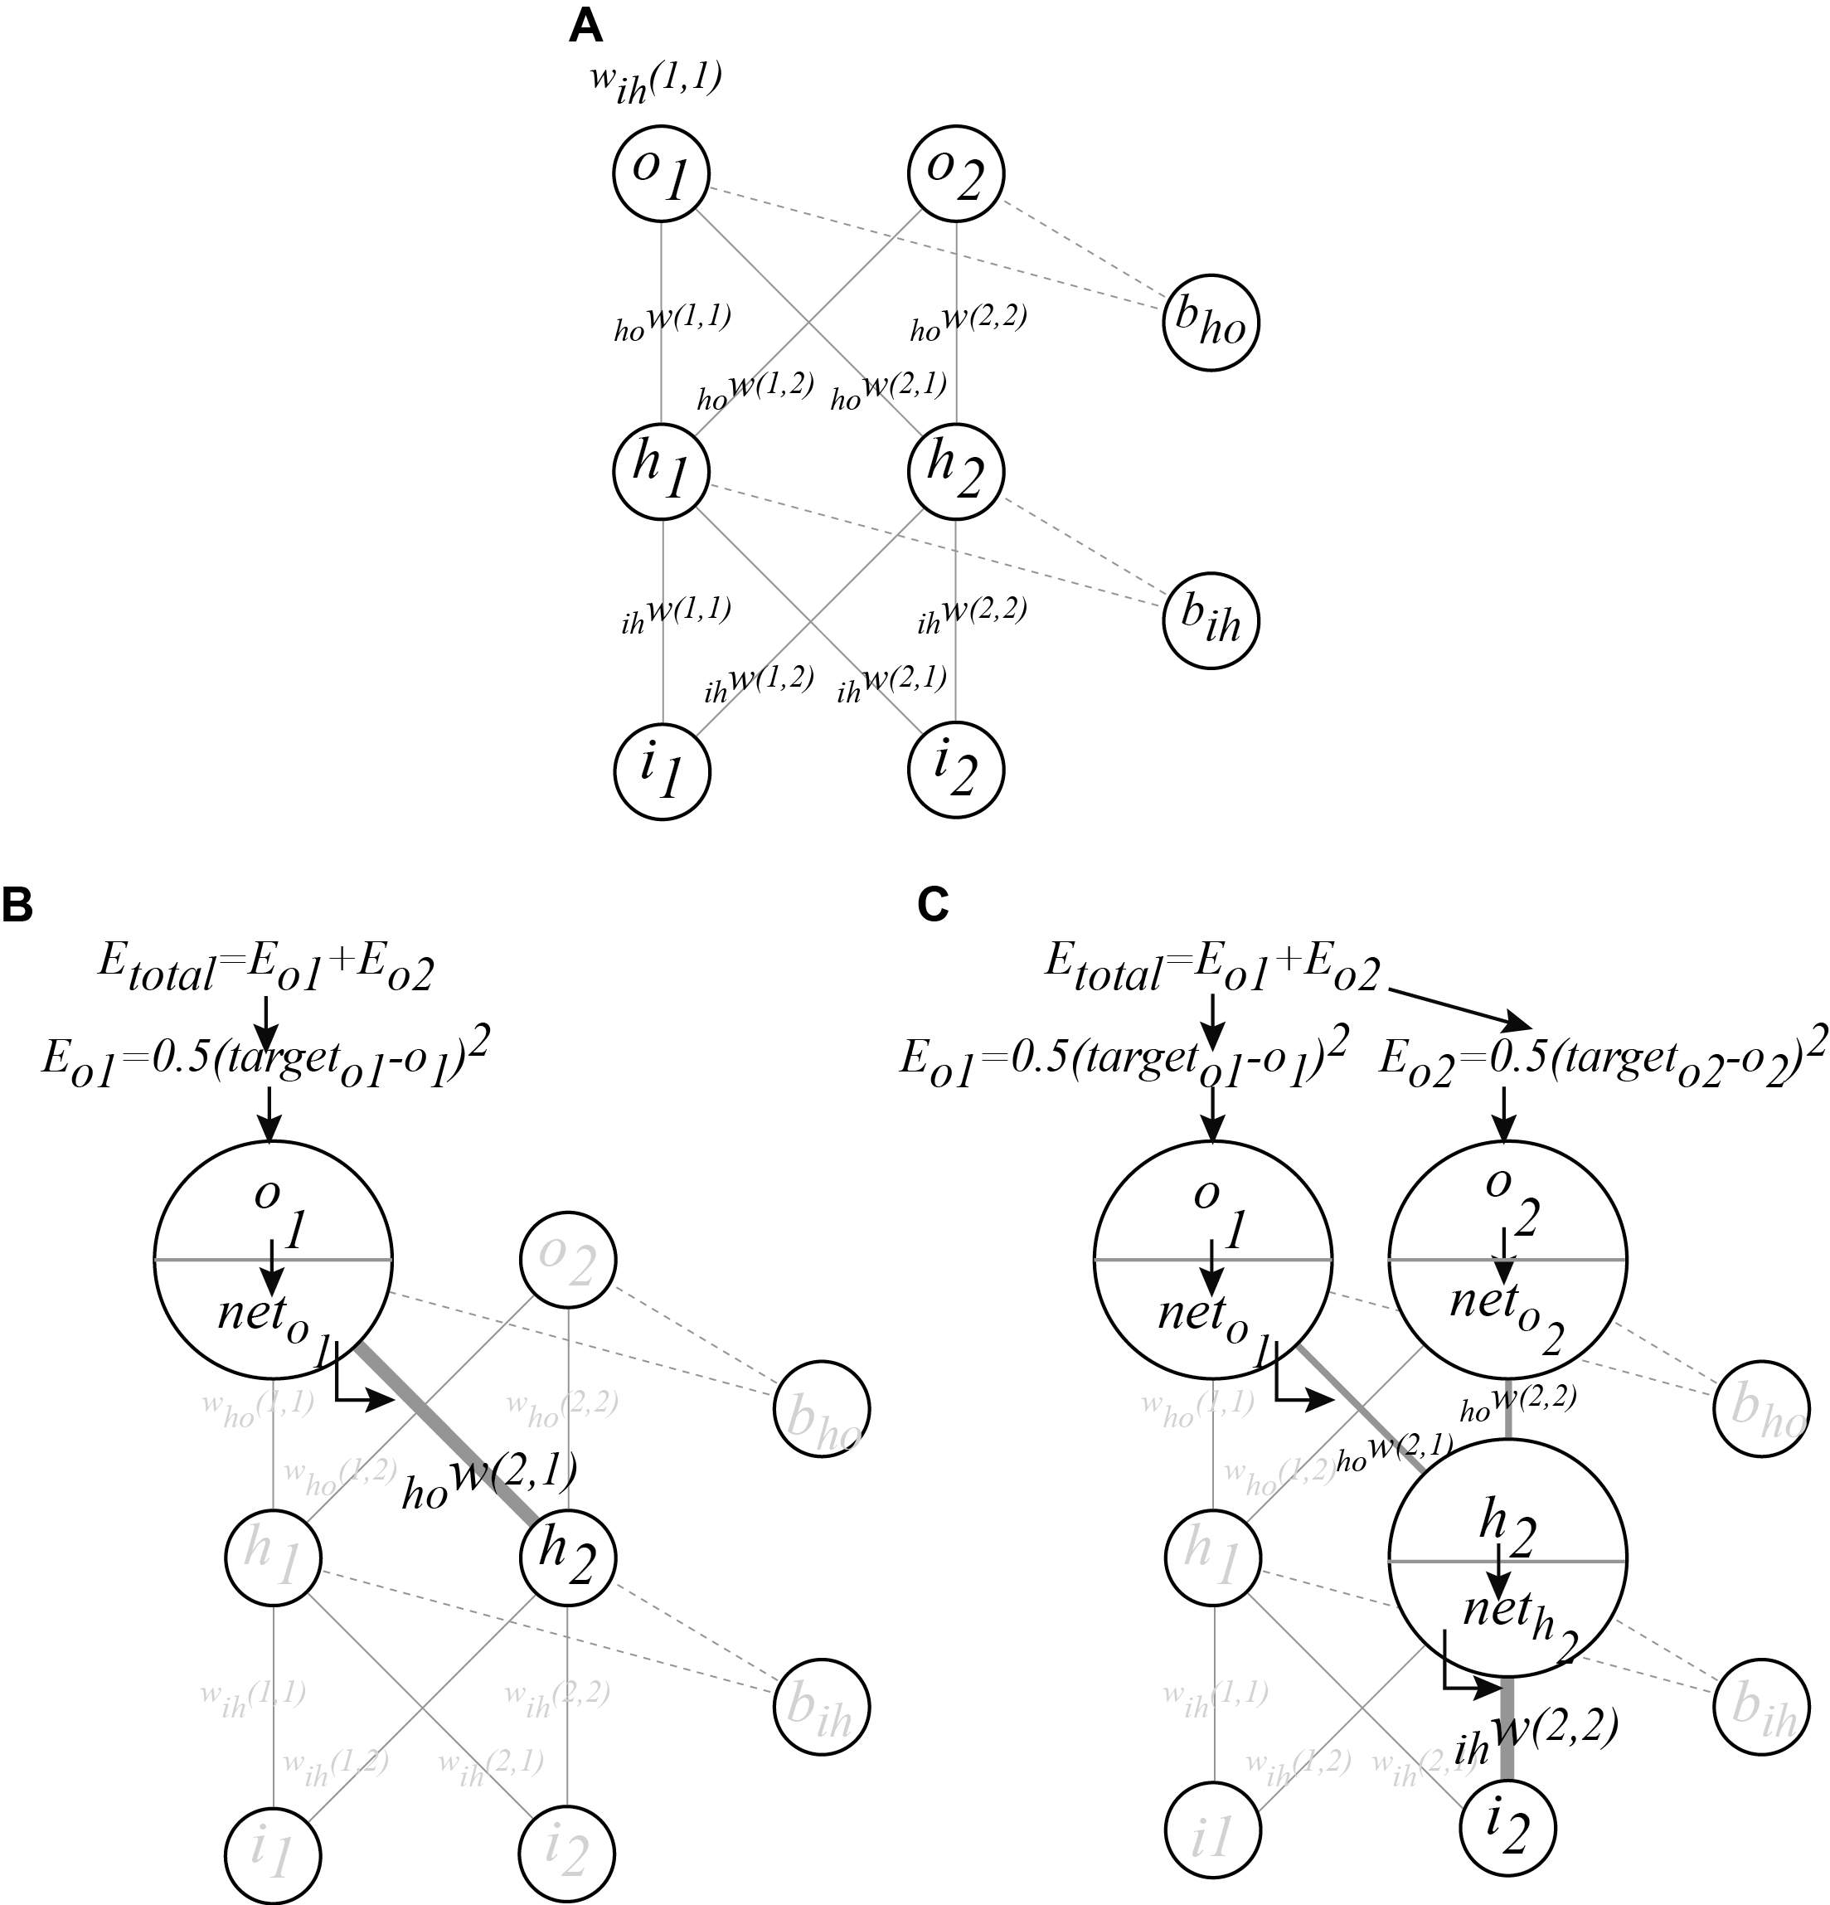
Figure VIII-3

Slide 4
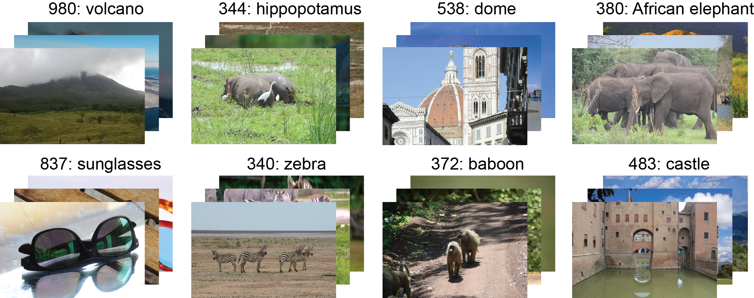
Figure VIII-4

Slide 5
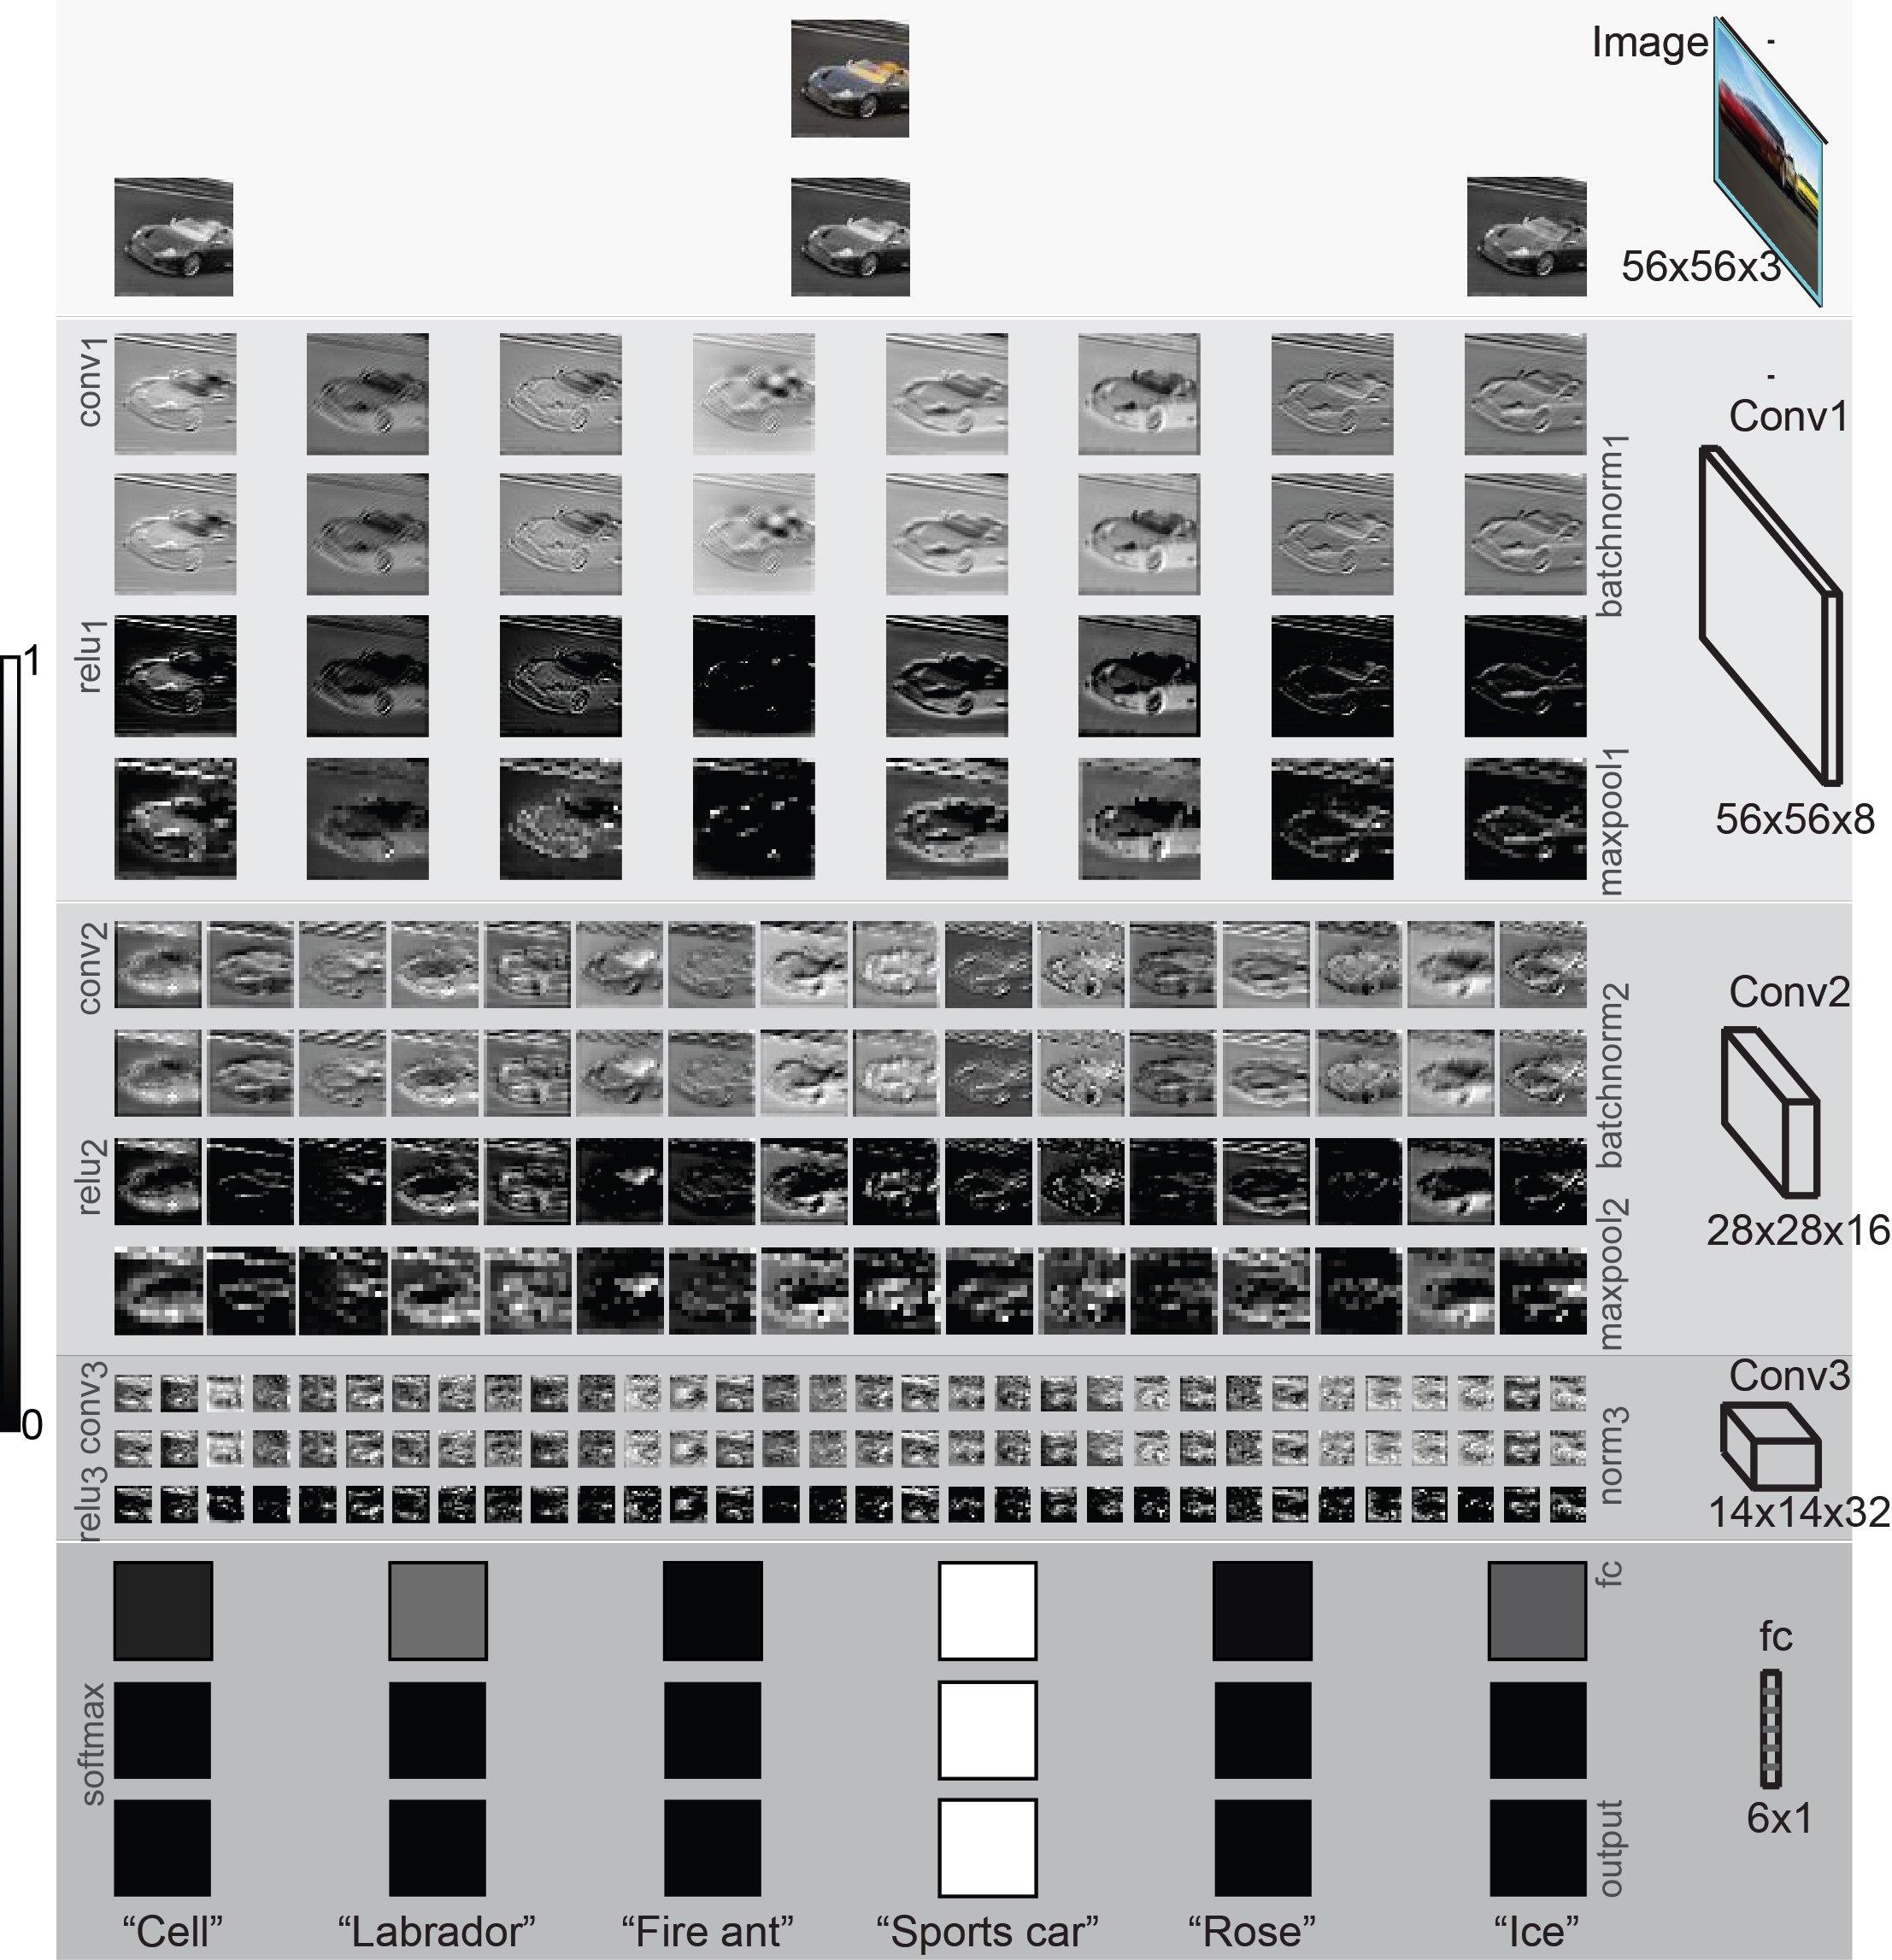
Figure VIII-5

Slide 6
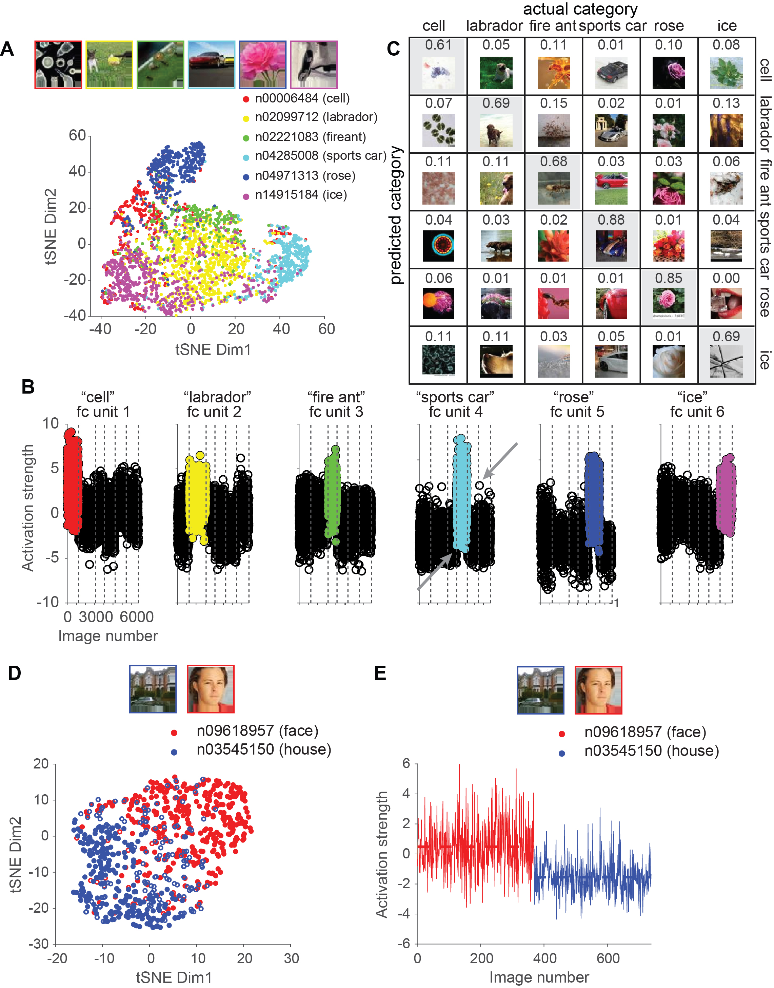
Figure VIII-6

Slide 7
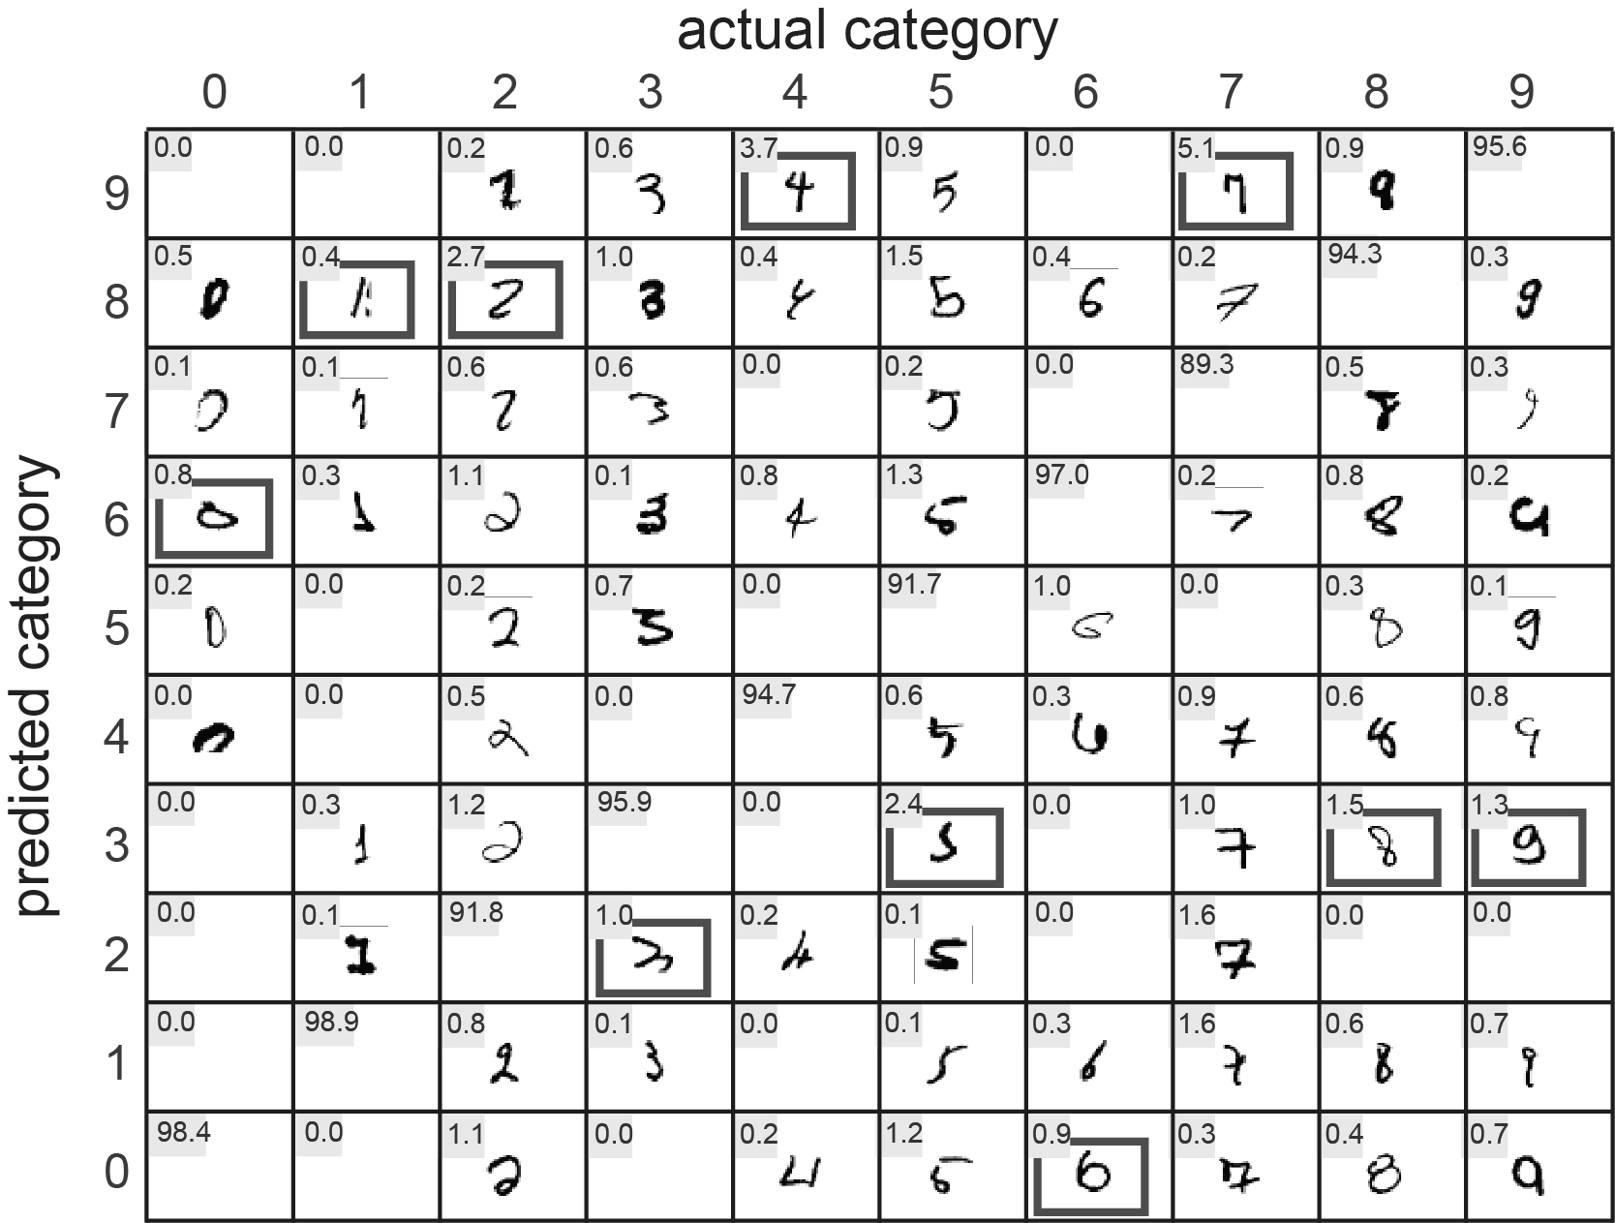
Figure VIII-7

Slide 8
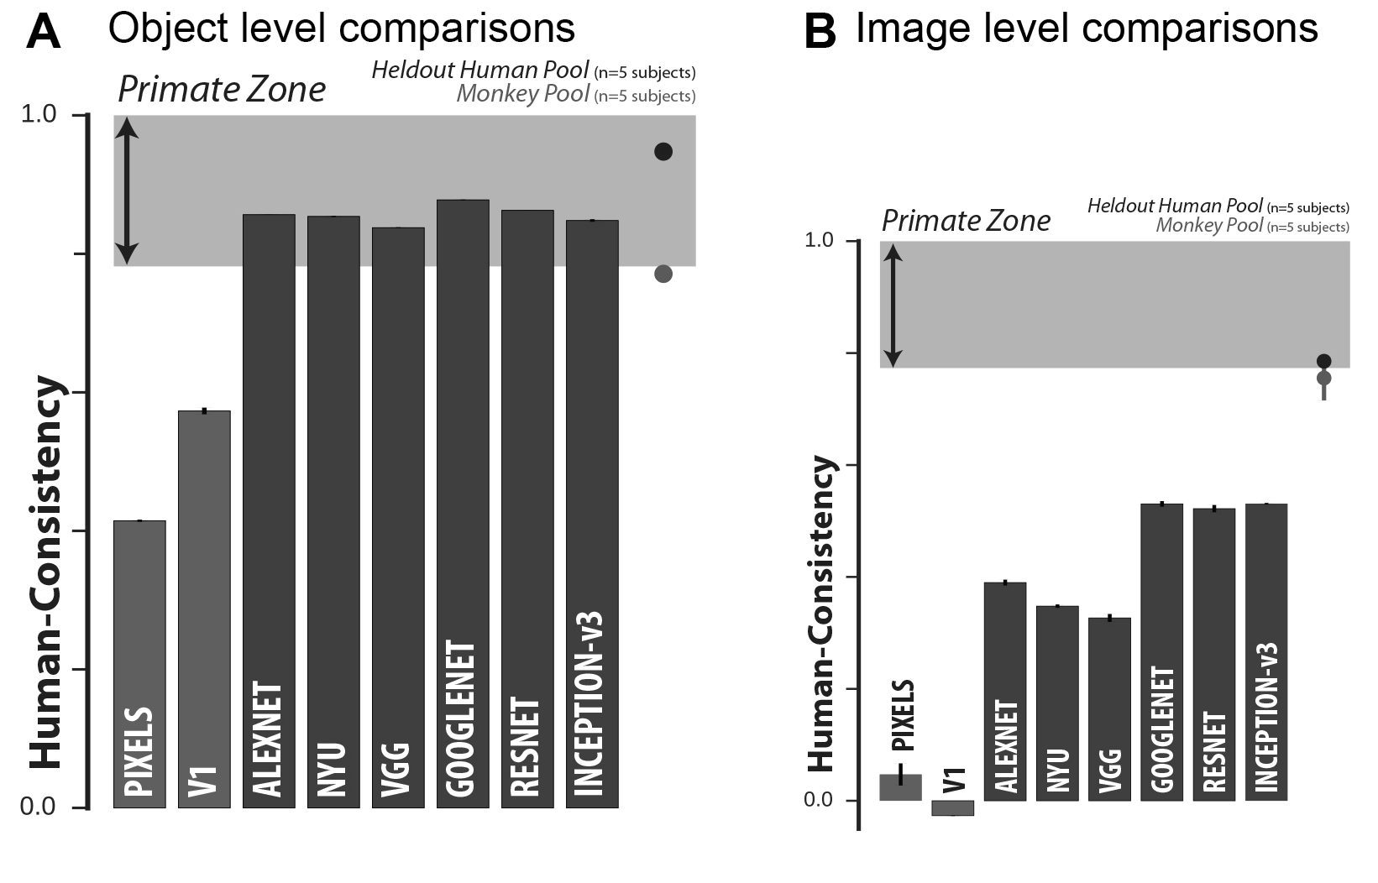
Figure VIII-8

Slide 9
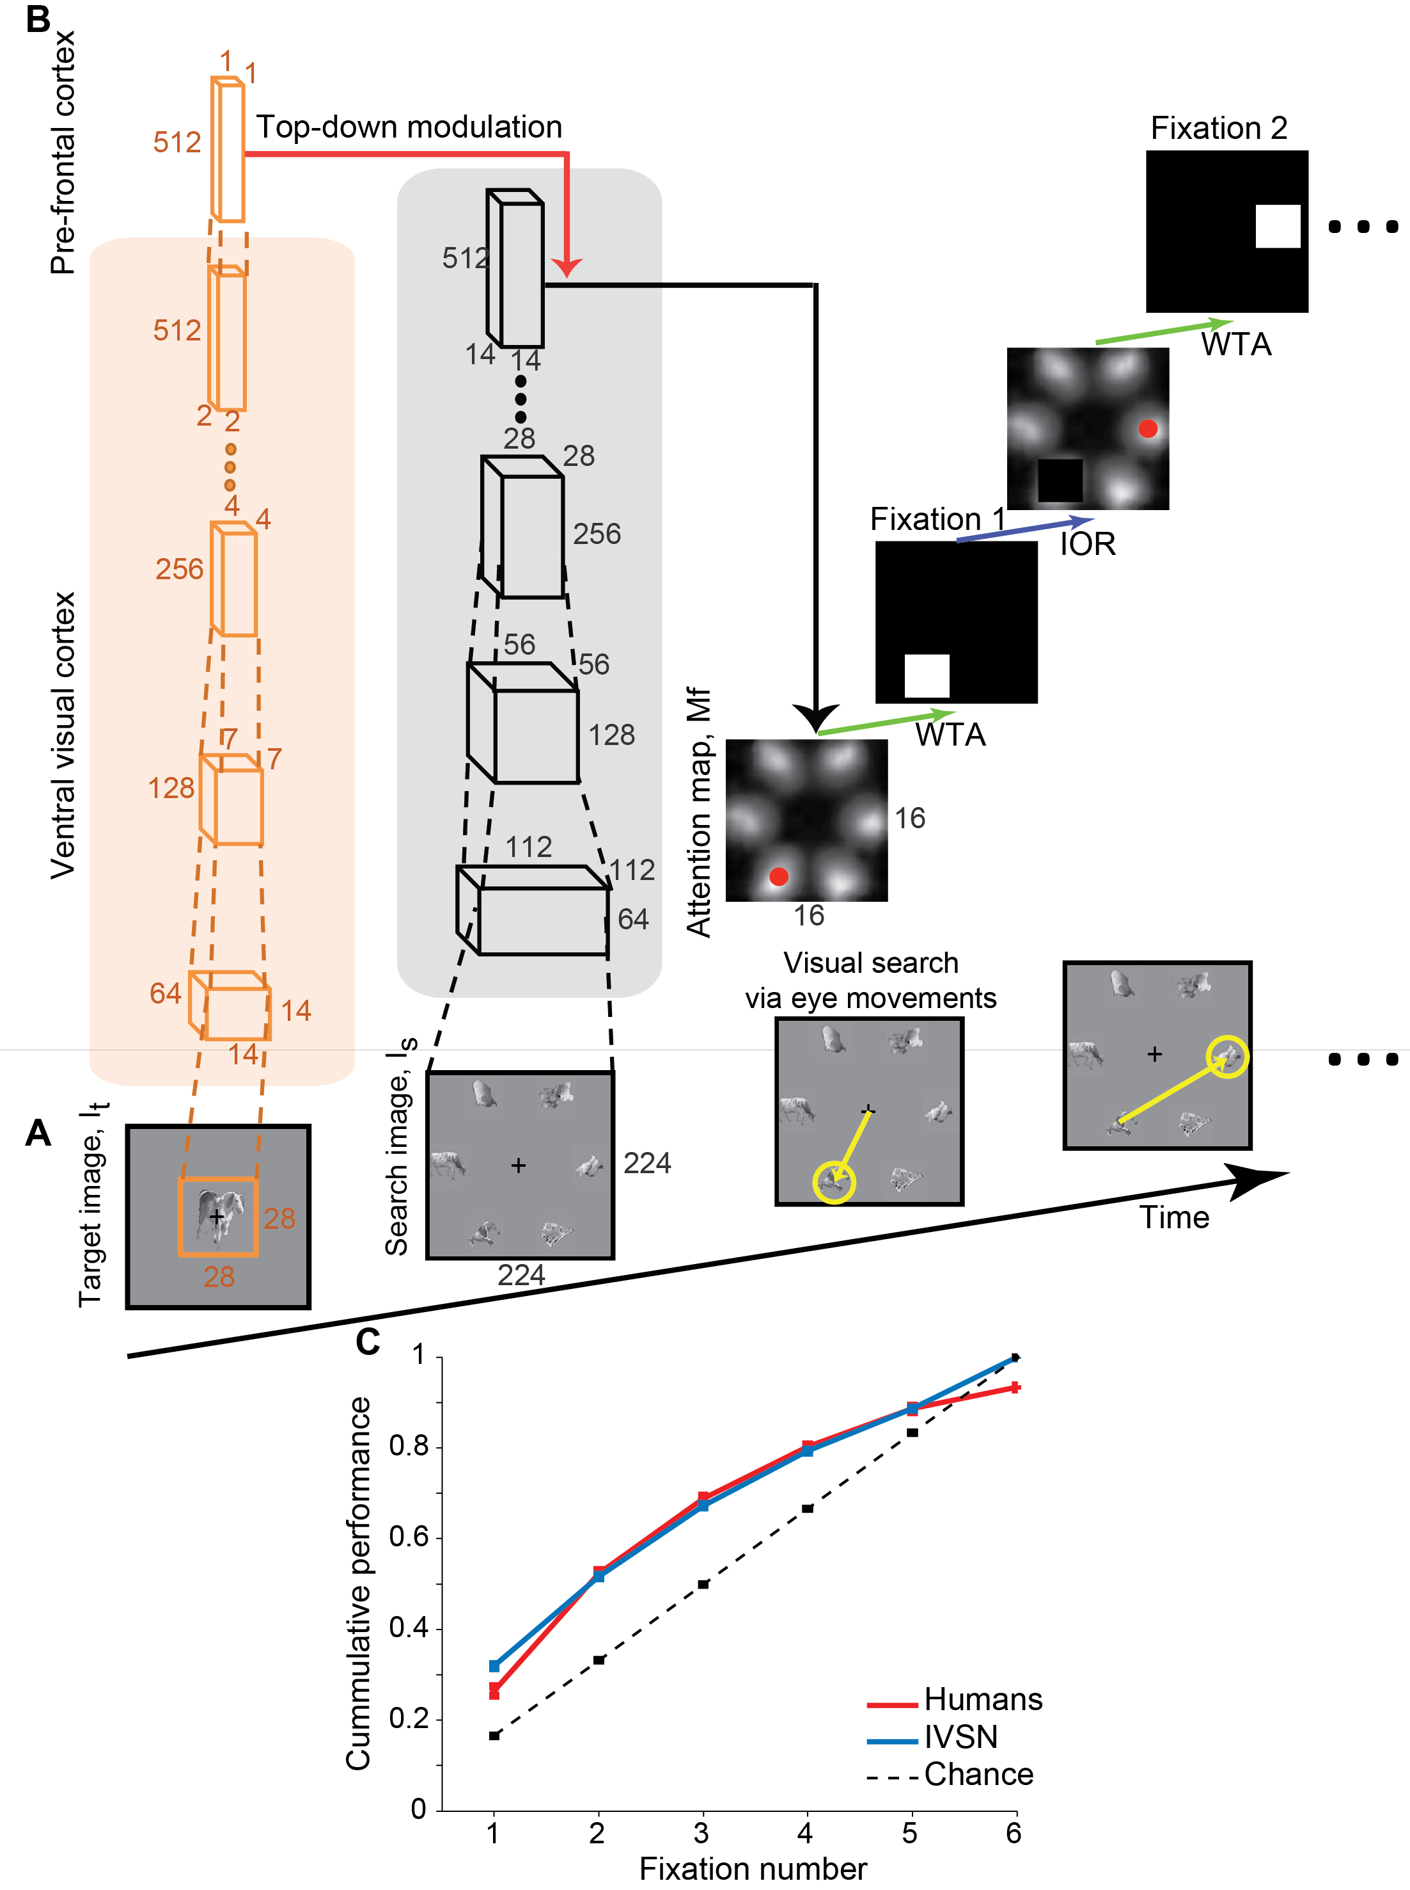
Figure VIII-9

Slide 10
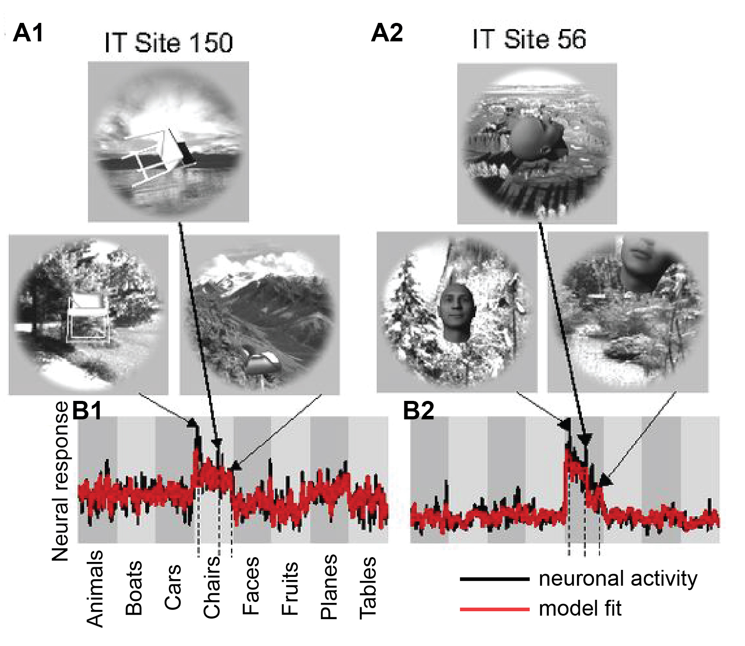
Figure VIII-10

Slide 11
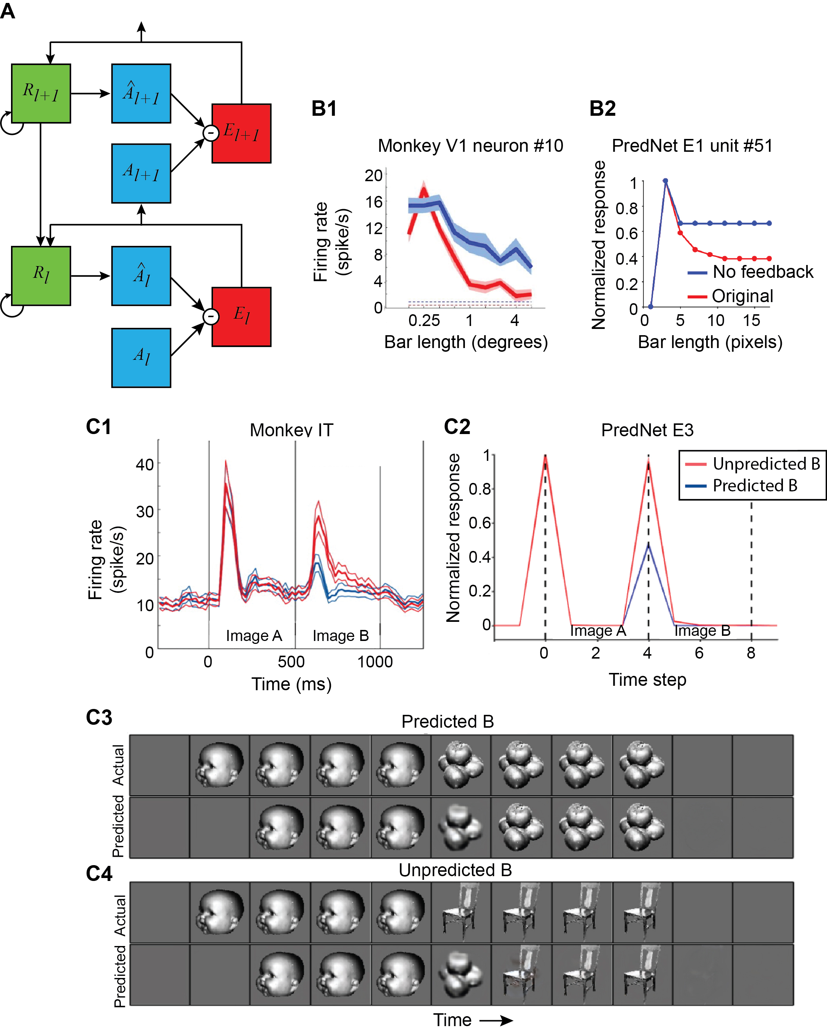
Figure VIII-11

