Slide 1
Figure IX-1

Slide 2
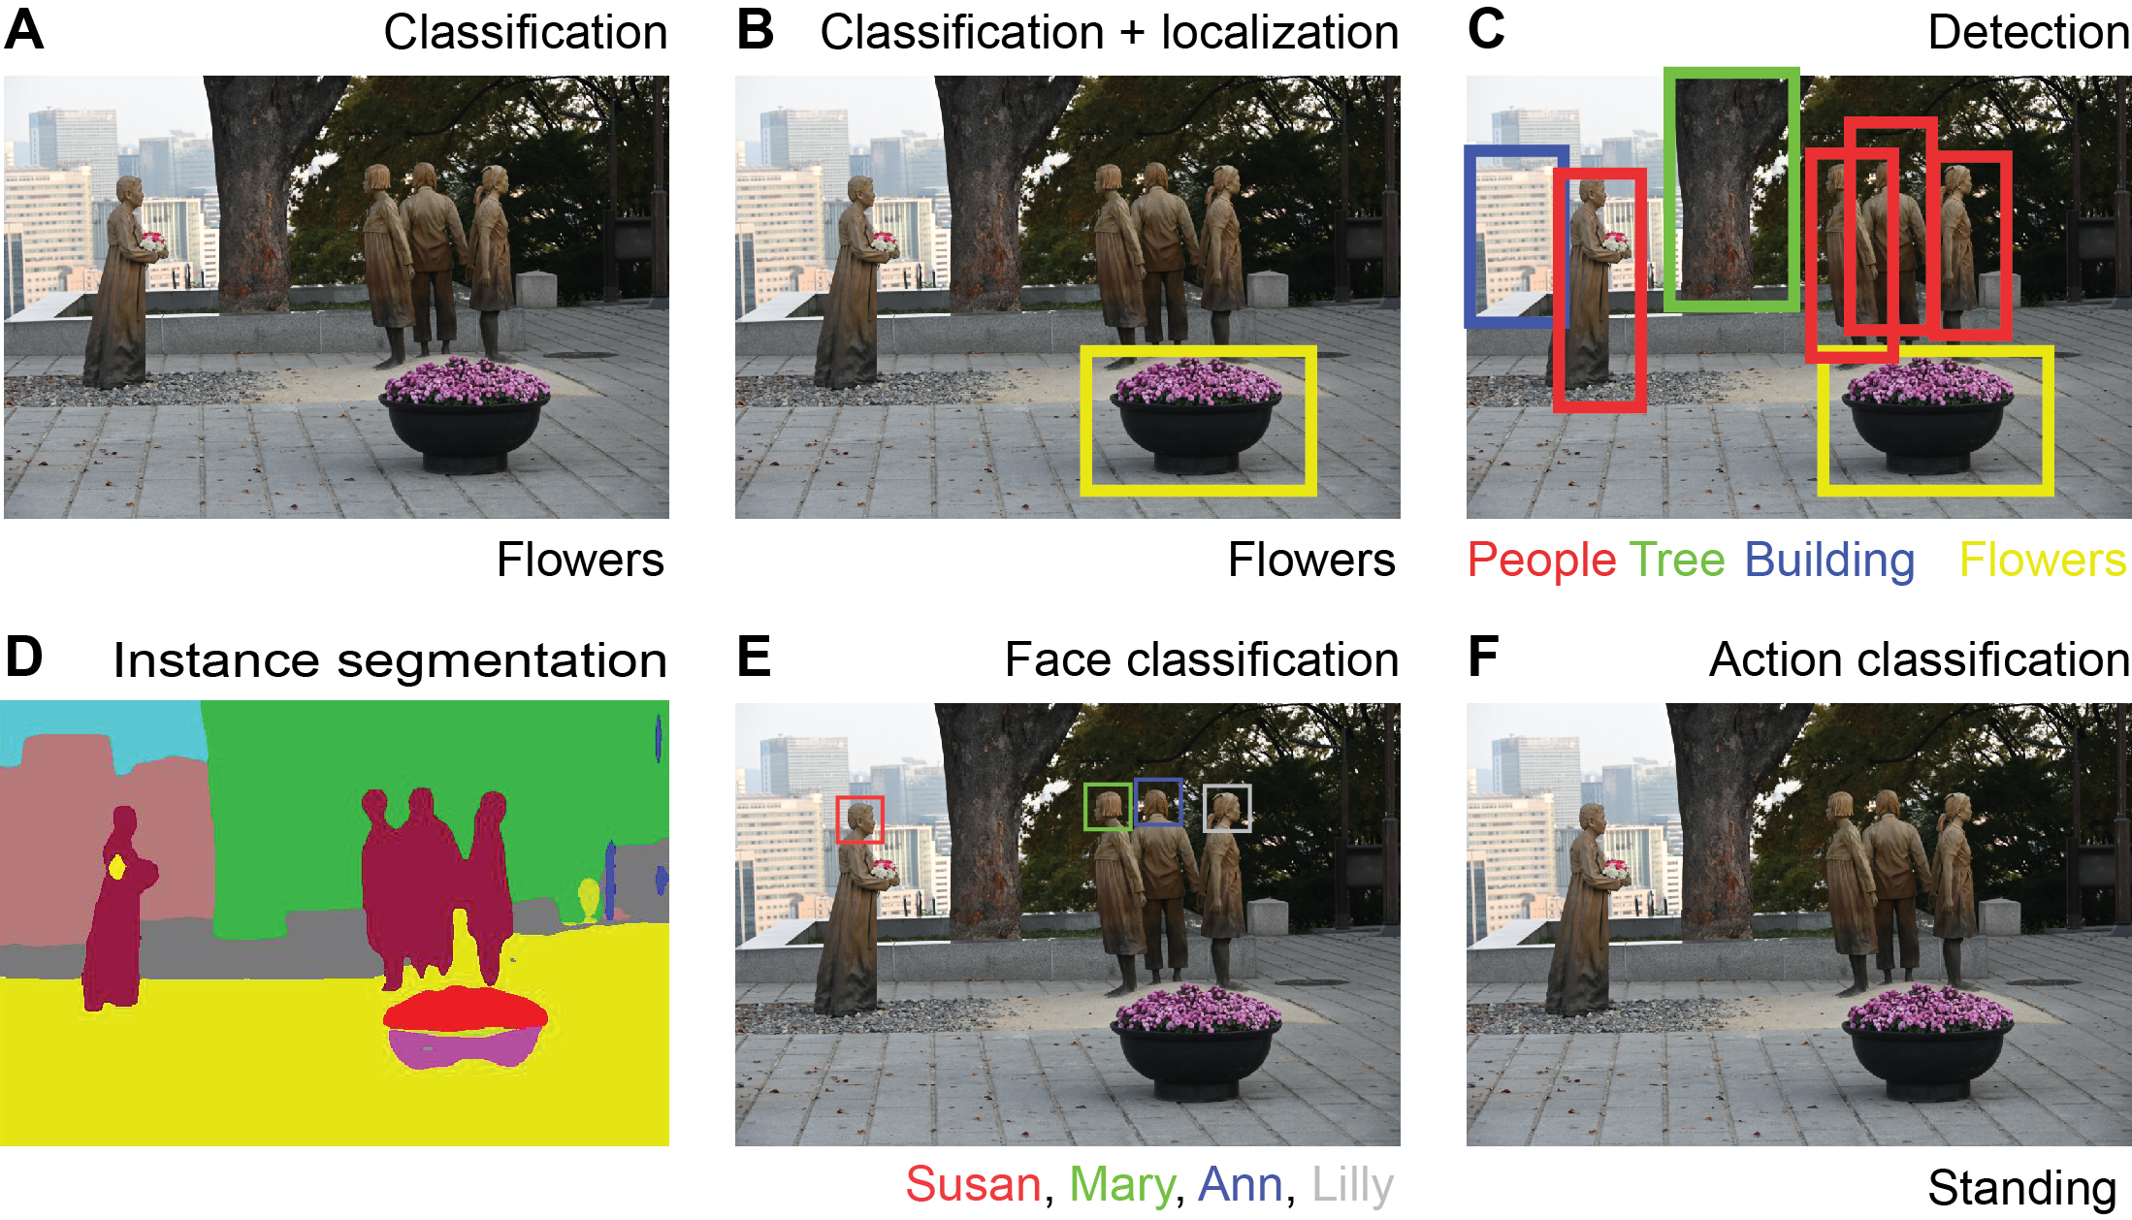
Figure IX-2

Slide 3
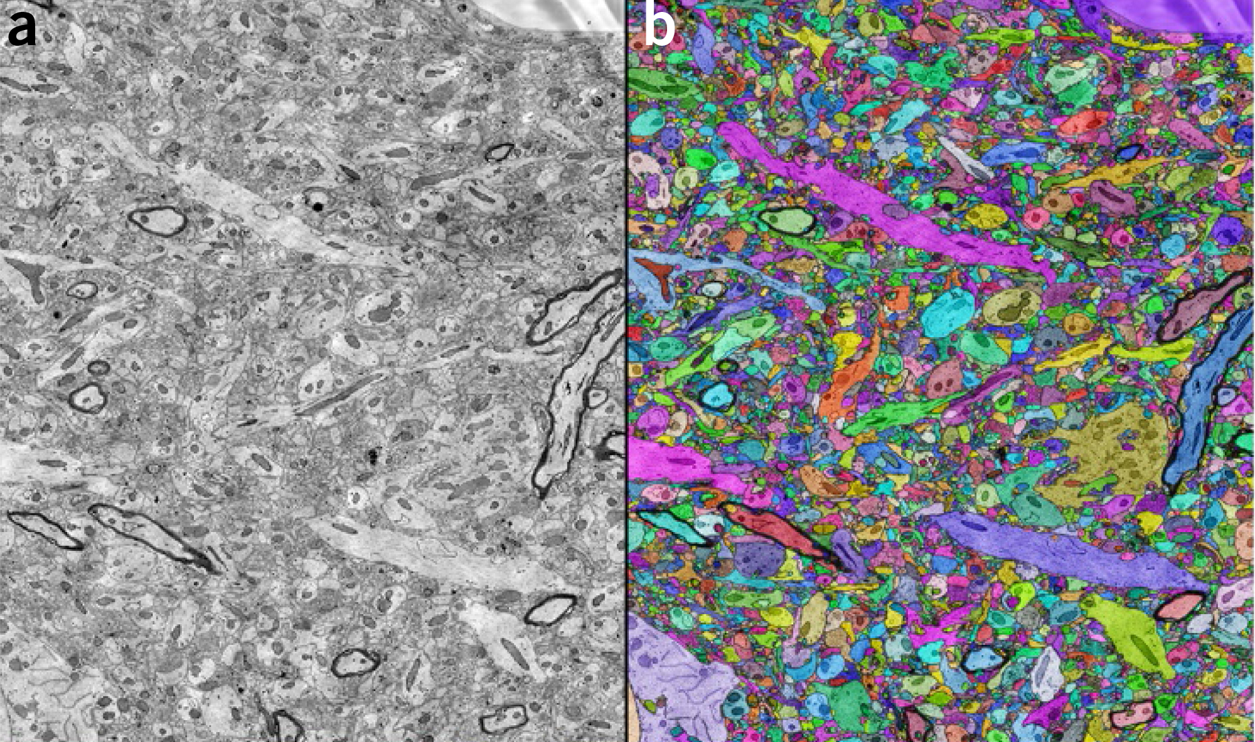
Figure IX-3

Slide 4
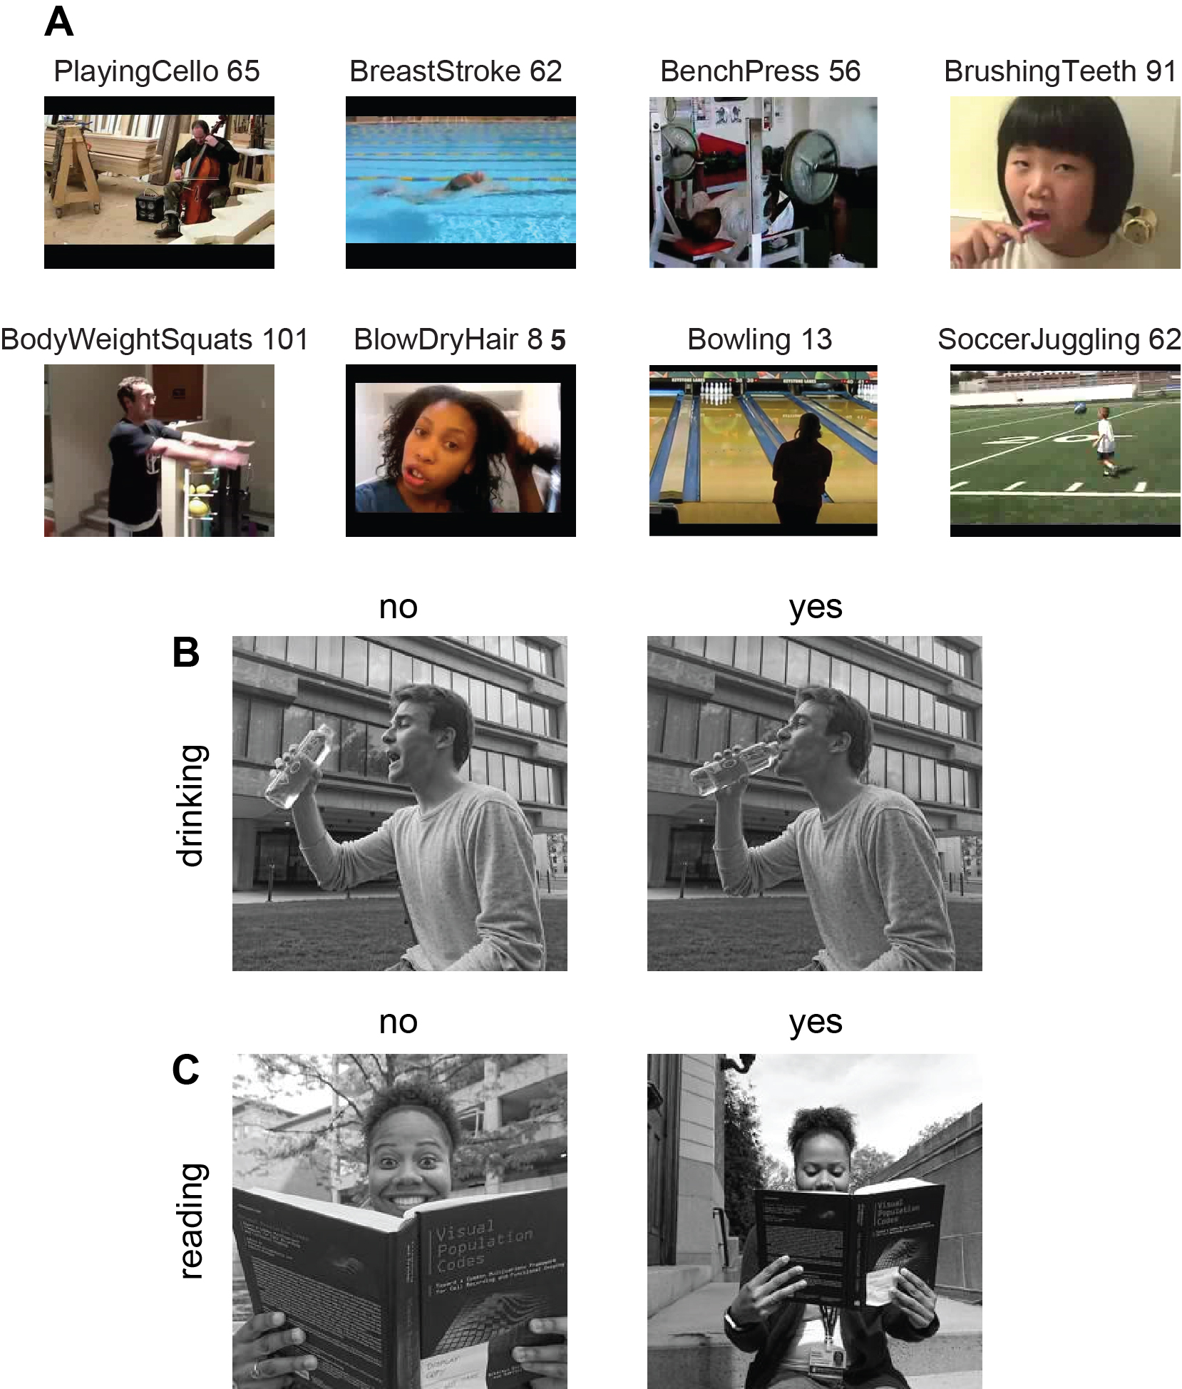
Figure IX-4

Slide 5
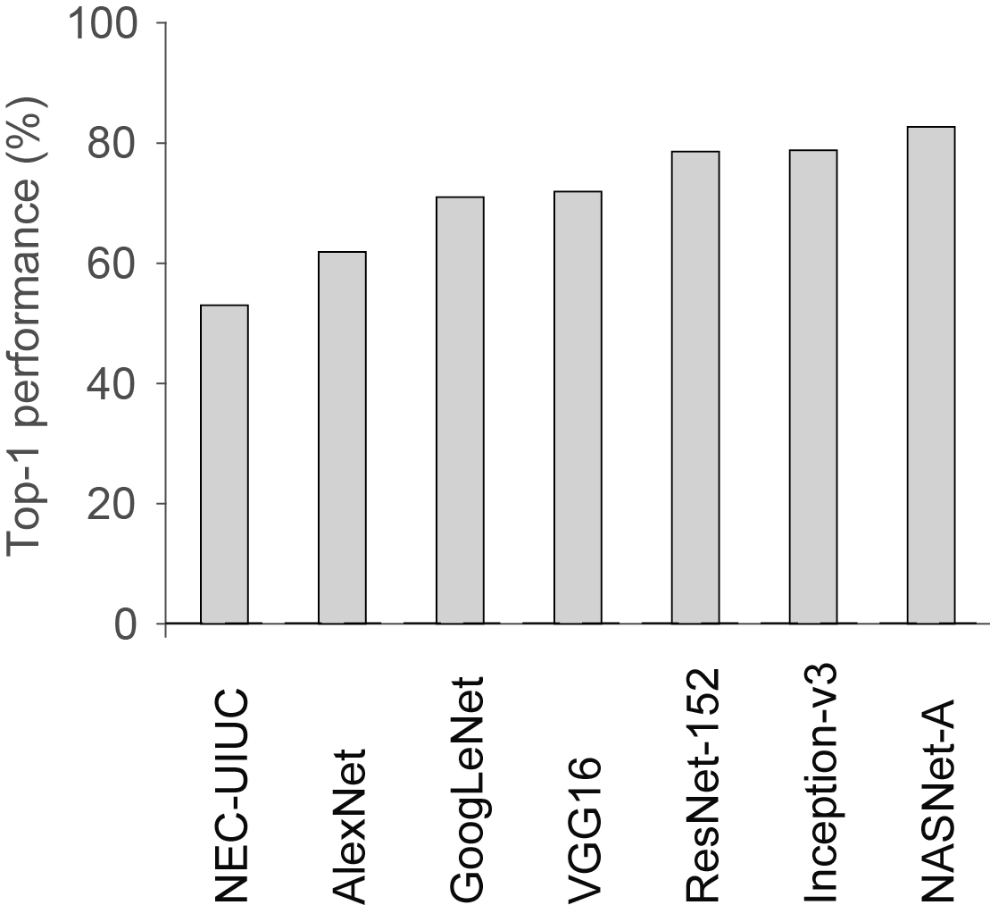
Figure IX-5

Slide 6
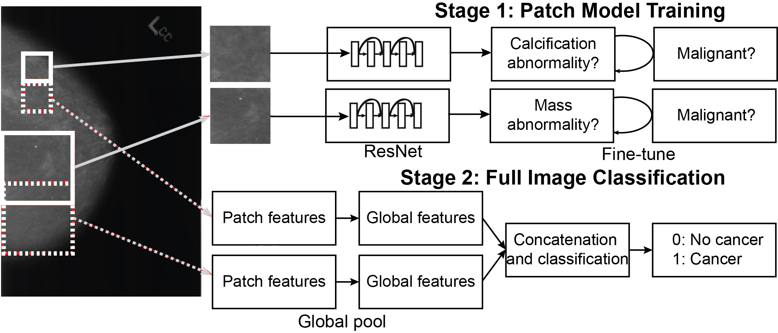
Figure IX-6

Slide 7
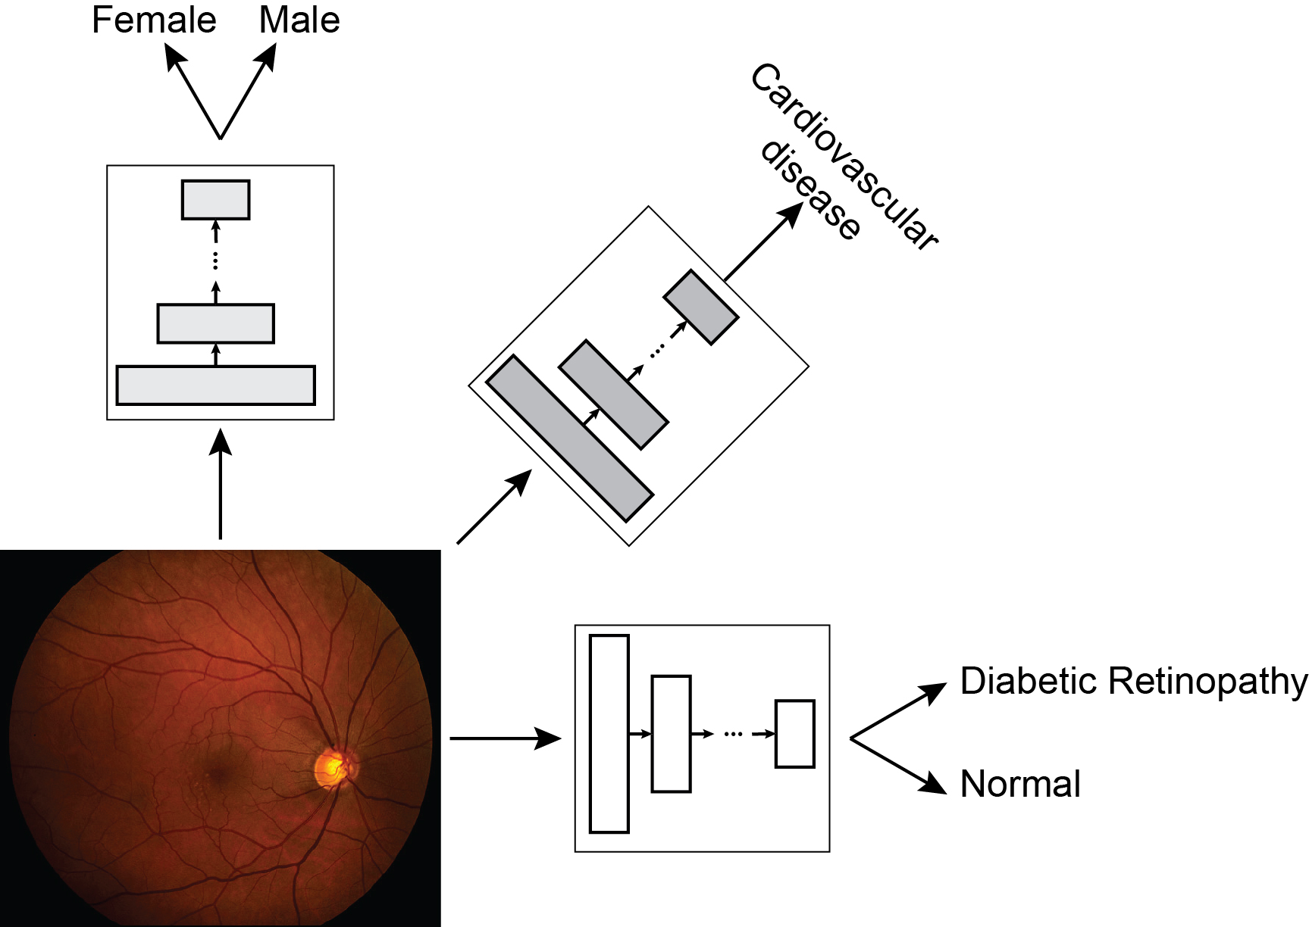
Figure IX-7

Slide 8
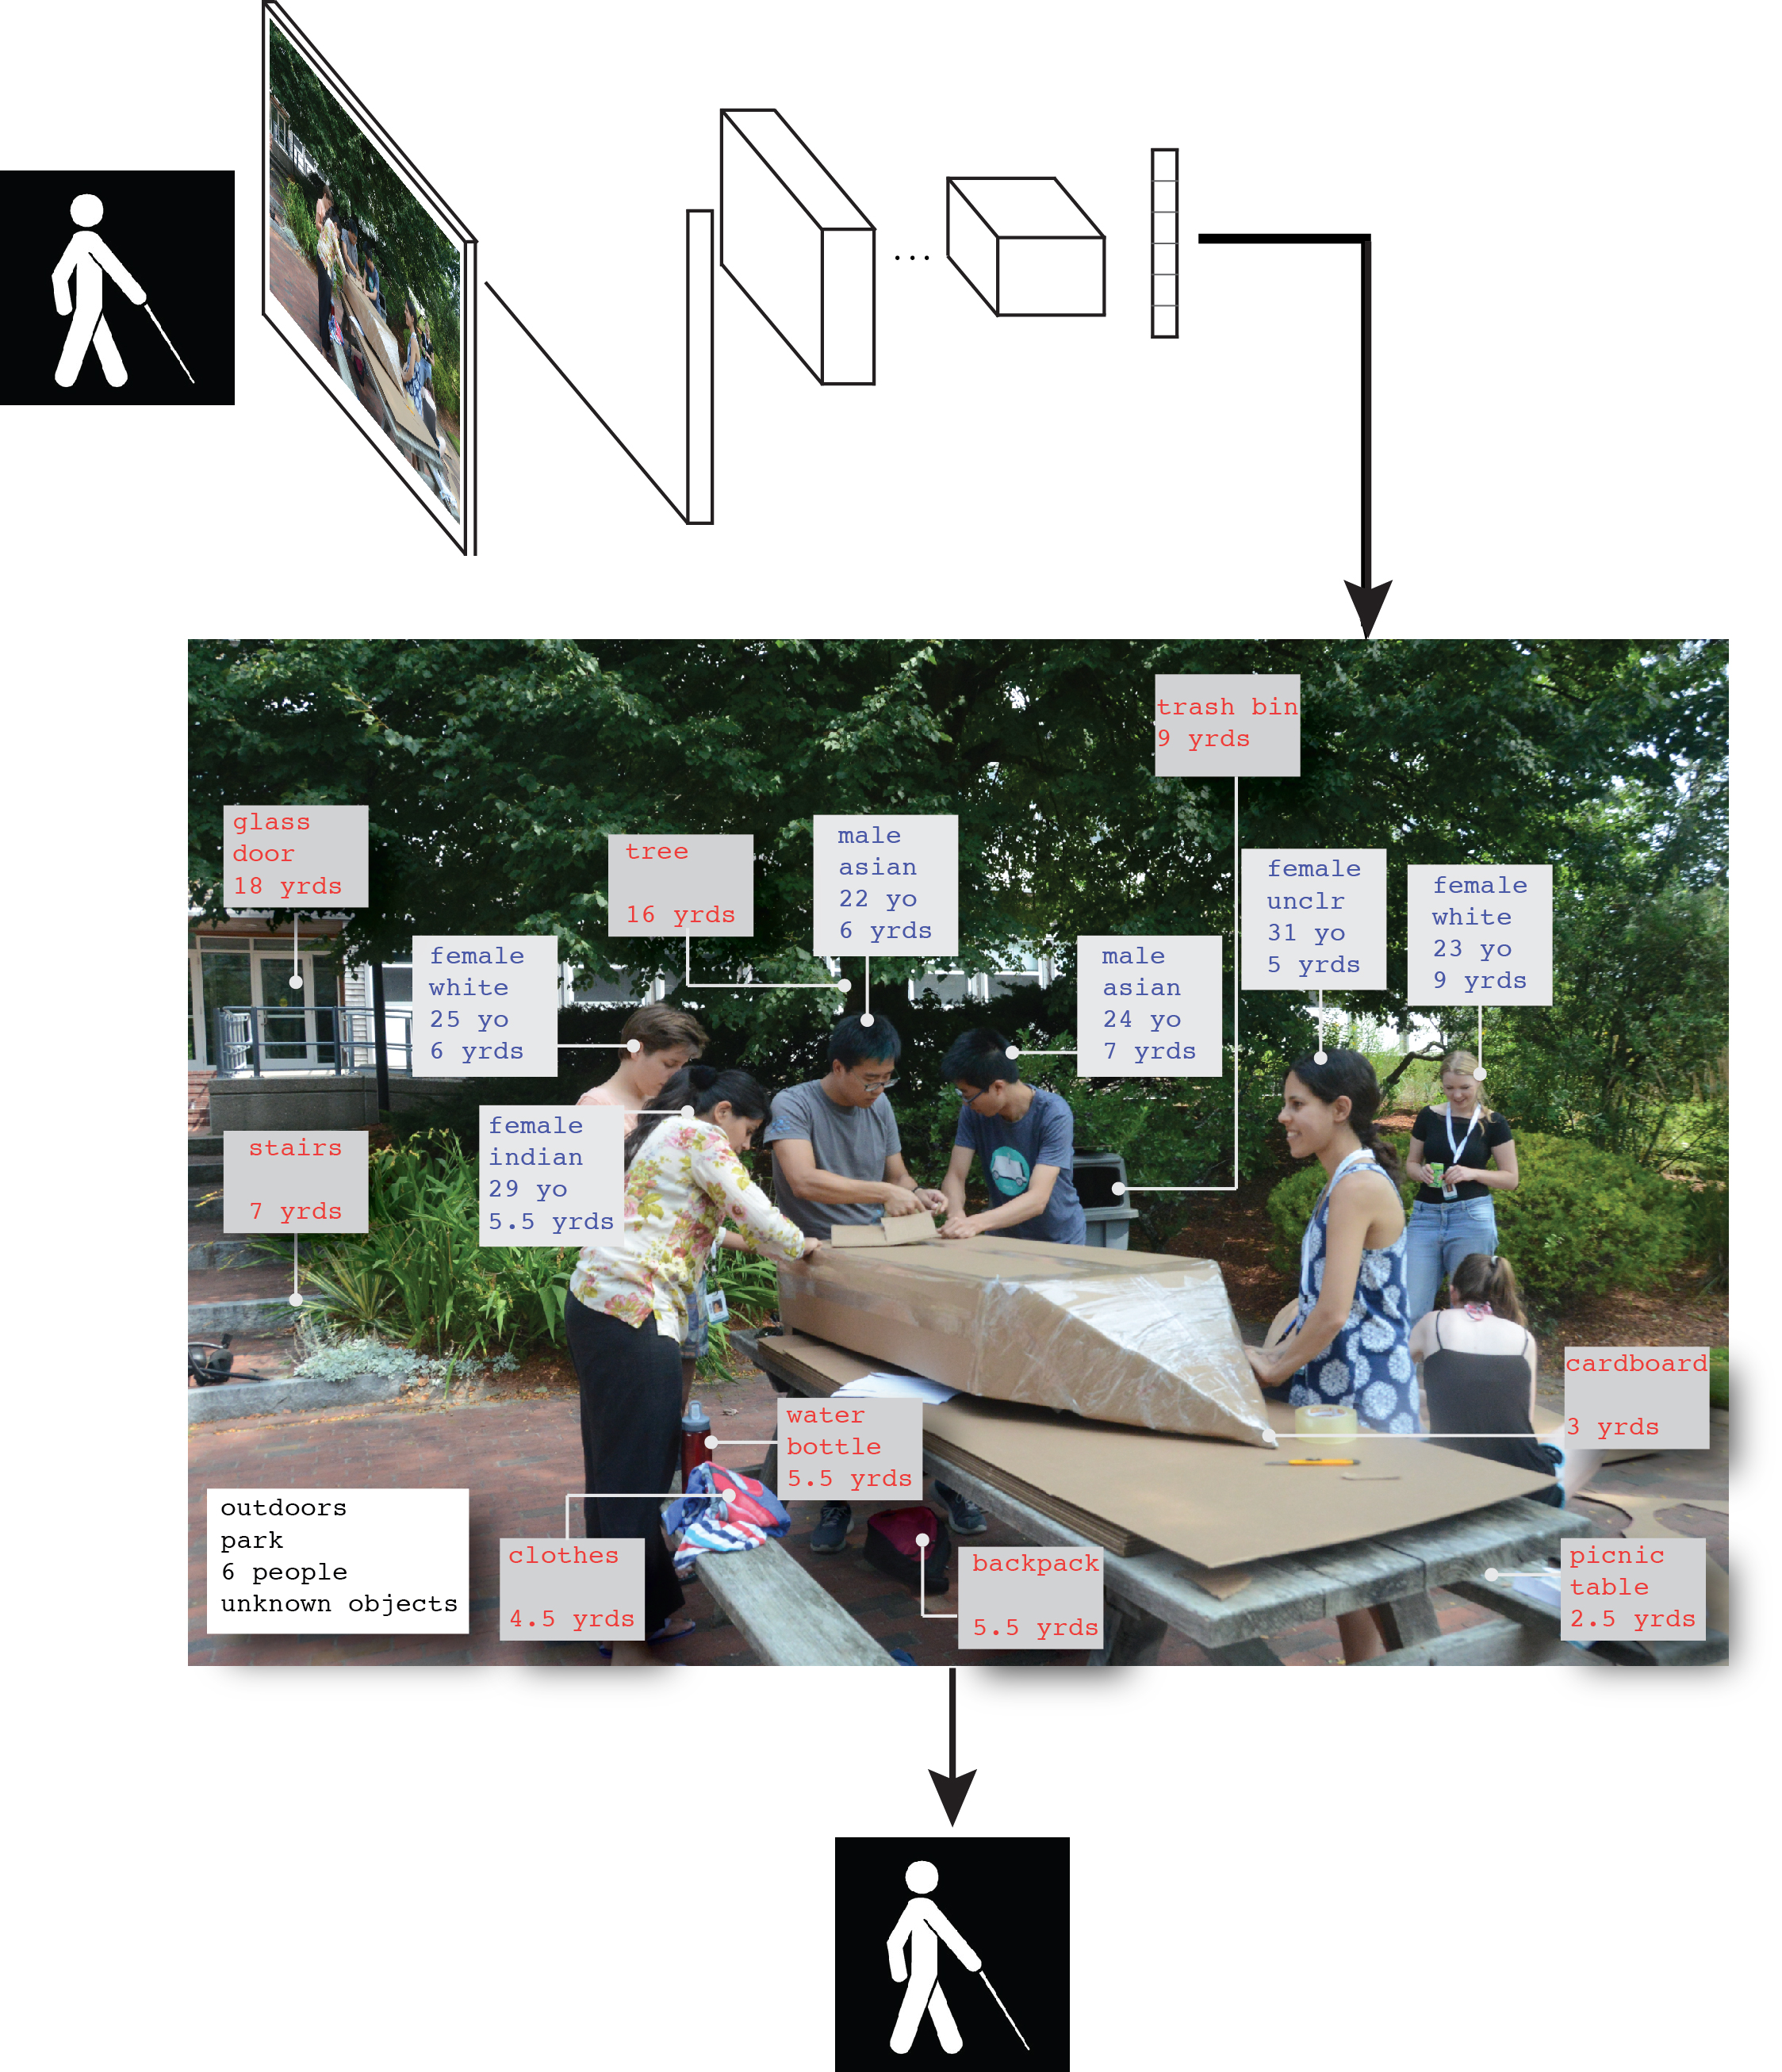
Figure IX-8

Slide 9
Figure IX-9

Slide 10
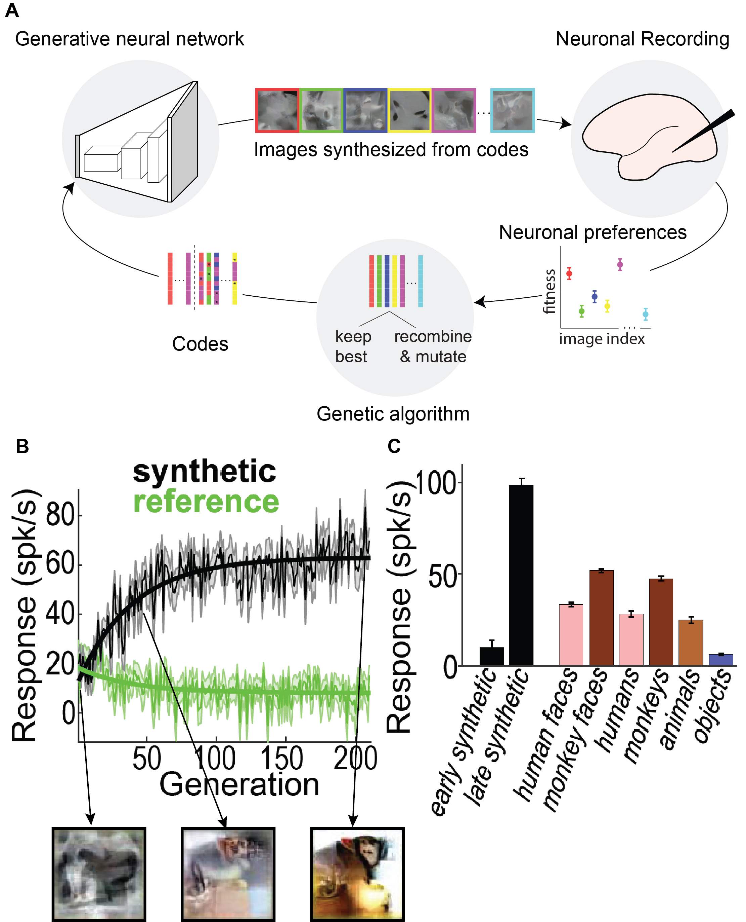
Figure IX-10

Slide 11
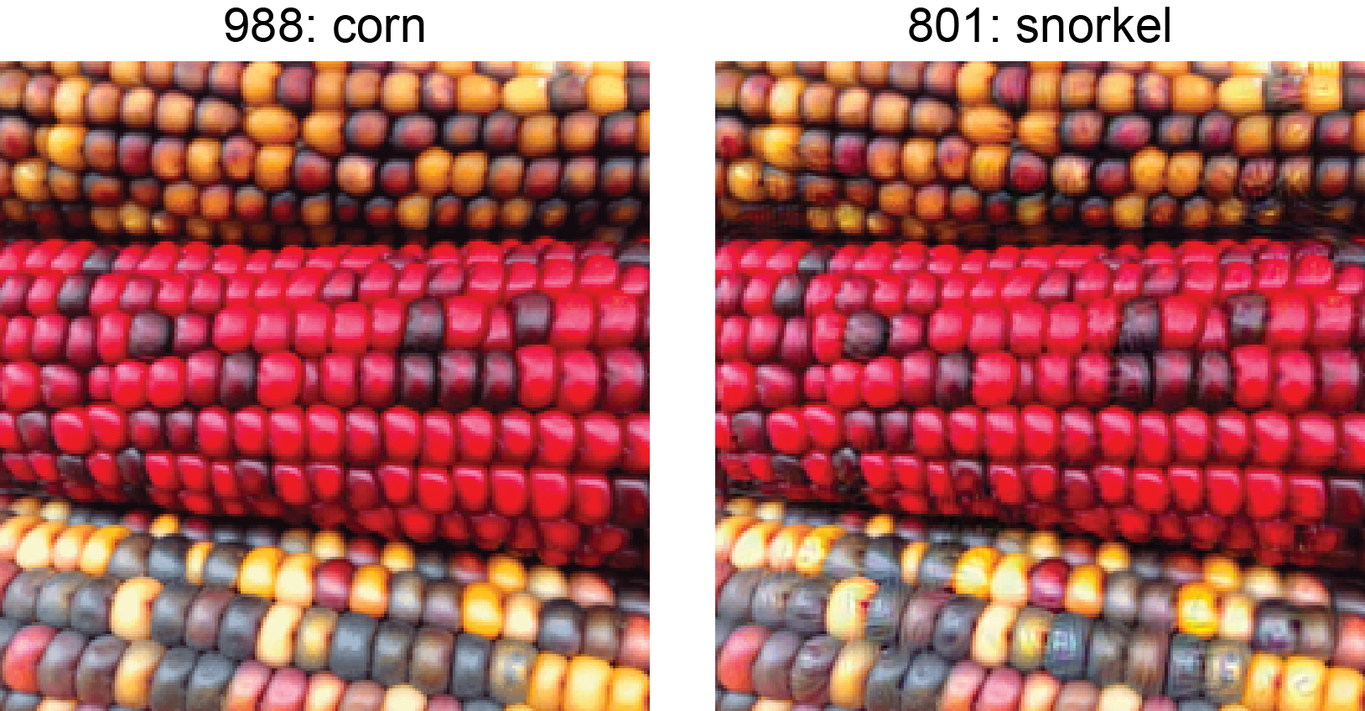
Figure IX-11

Slide 12
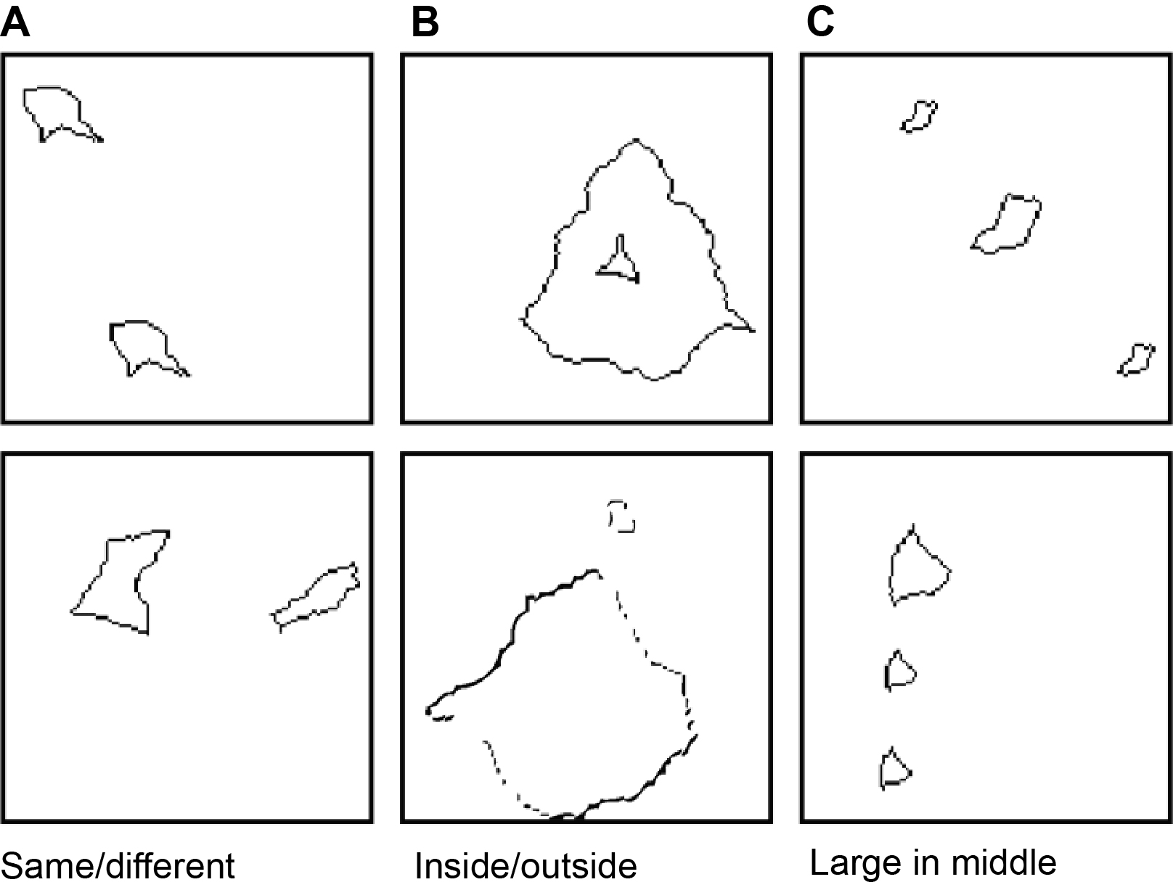
Figure IX-12

Slide 13
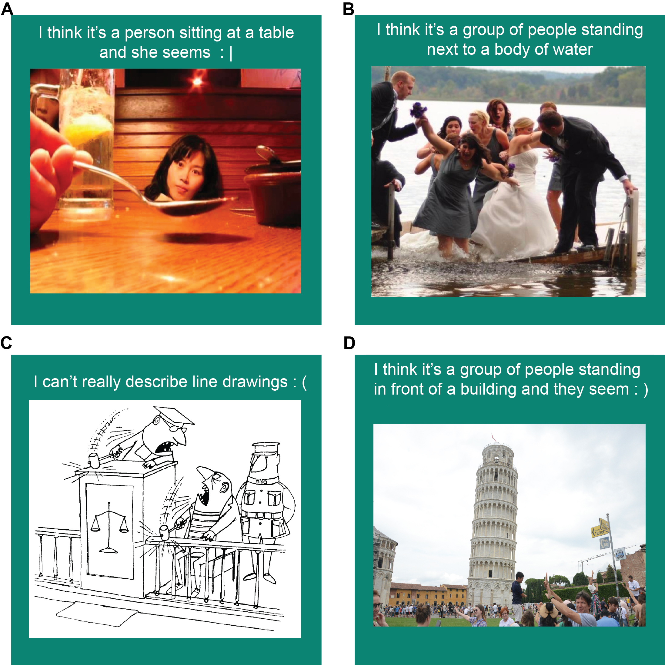
Figure IX-13

